Slide 1

Notes:
1
1
Greetings/additional statements - Title

Slide 2
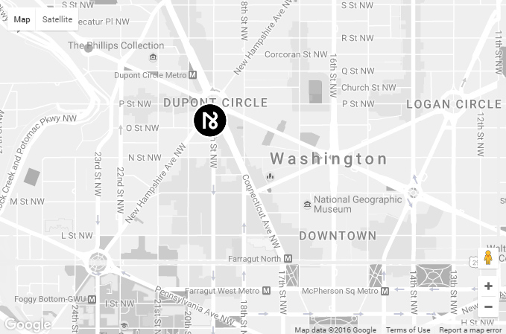

Notes:
2
(Innate location) In Washington, DC (national capital) in Dupont Circle district
2

Slide 3
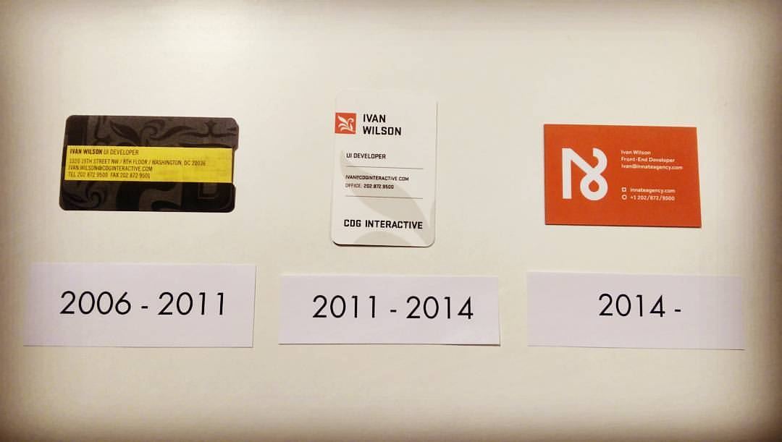
Notes:
3
3
10th Anniversary in April

Slide 4
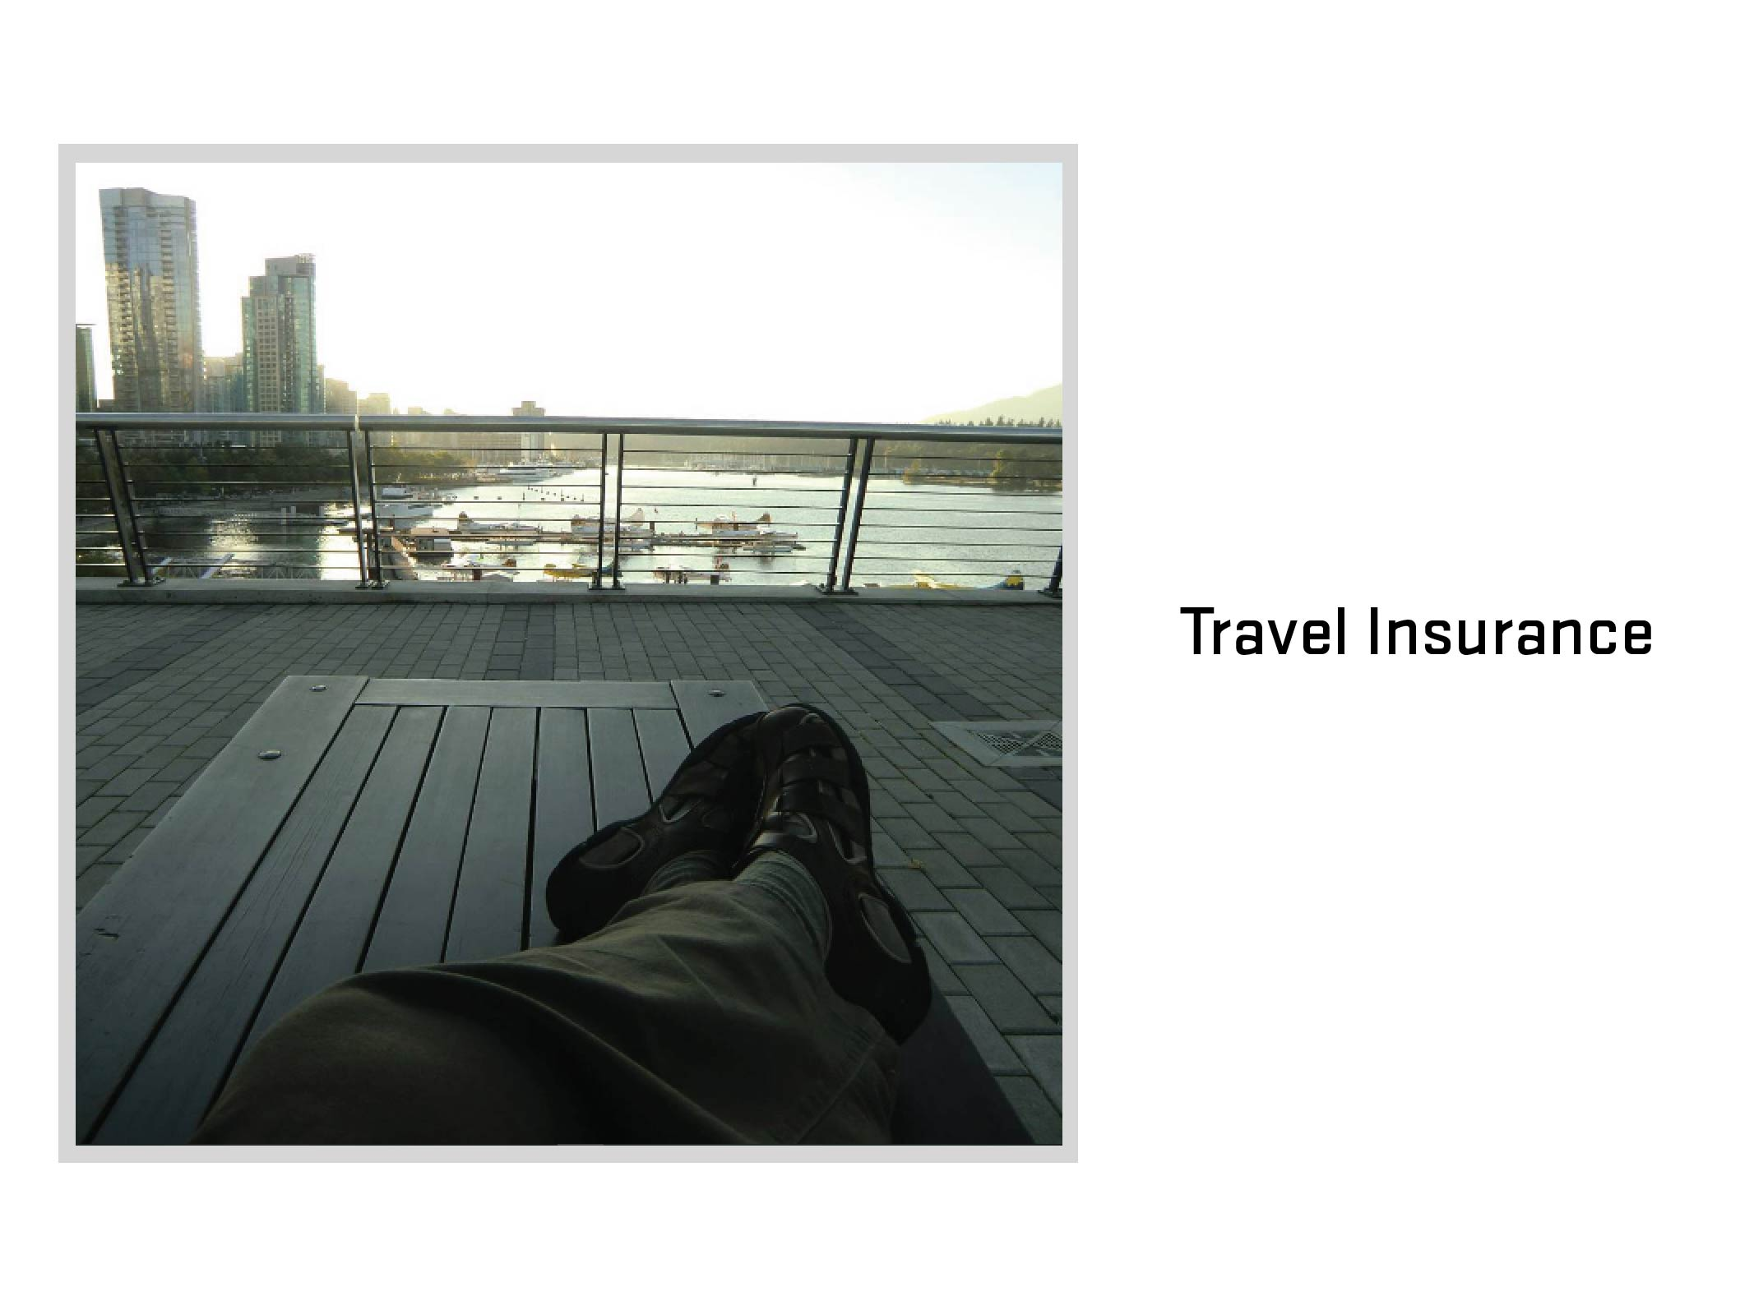
Notes:
4
4
Travel Insurance
What is travel insurance? (Ask audience)

Slide 5
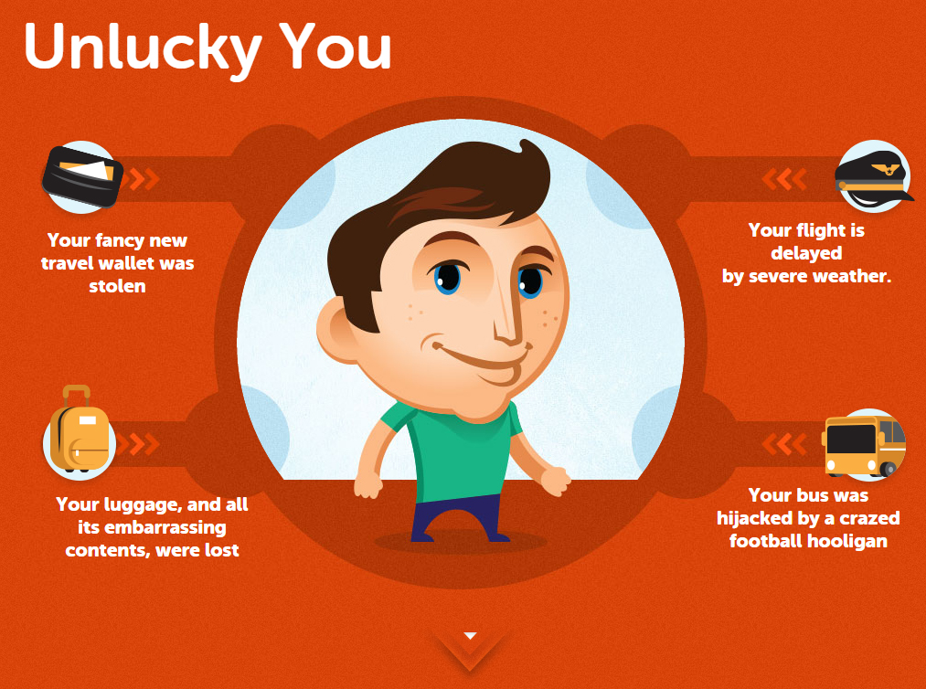
Notes:
5
5

Slide 6
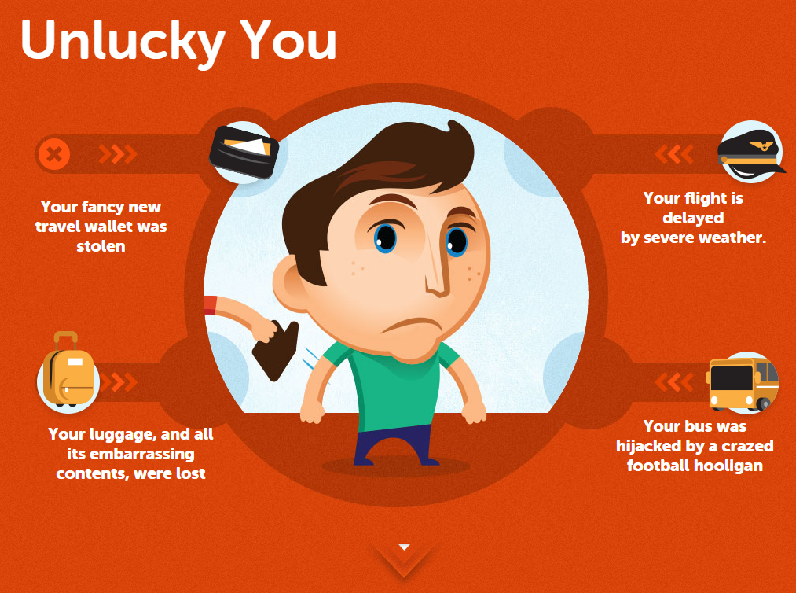
Notes:
6
6

Slide 7
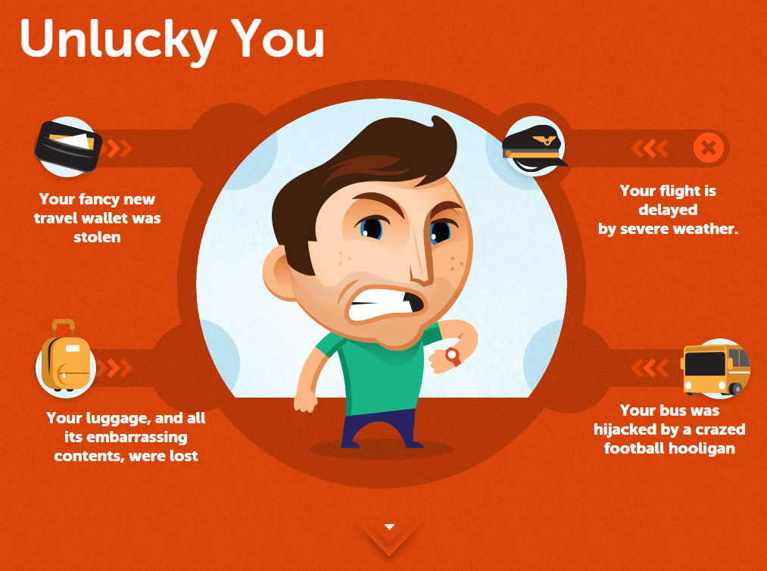
Notes:
7
7

Slide 8
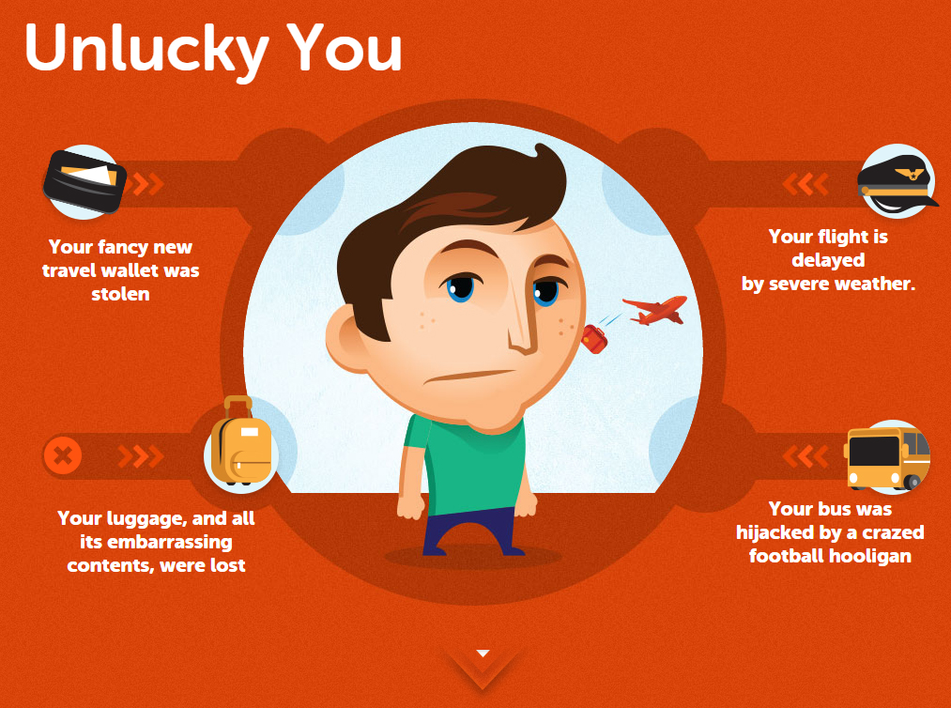
Notes:
8
8

Slide 9
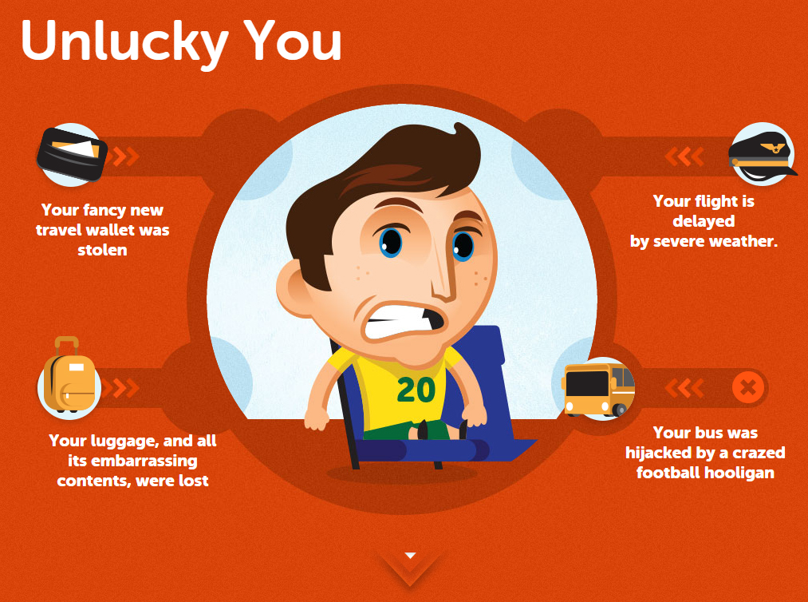
Notes:
9
9

Slide 10
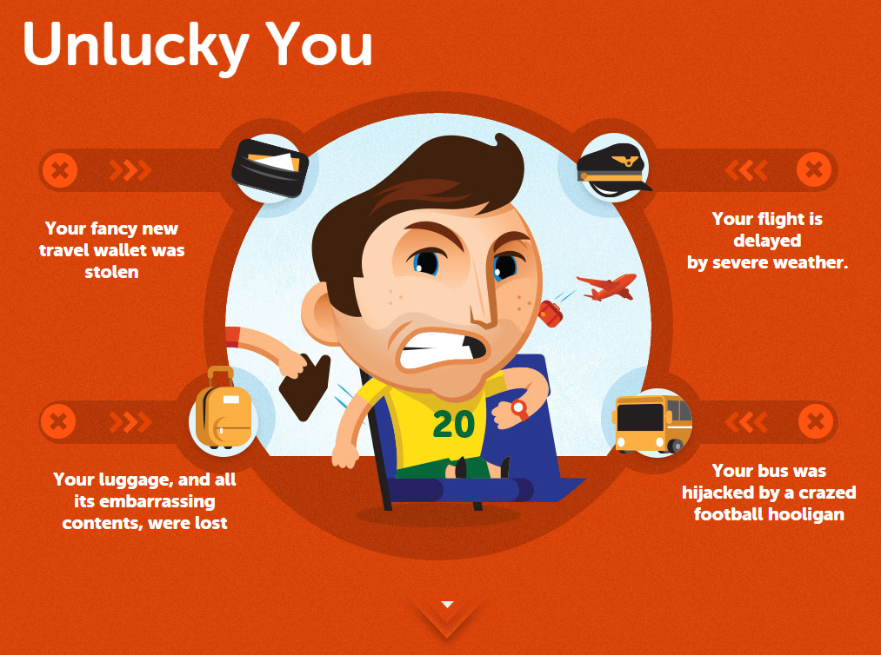
Notes:
10
10

Slide 11

Notes:
11
11

Slide 12
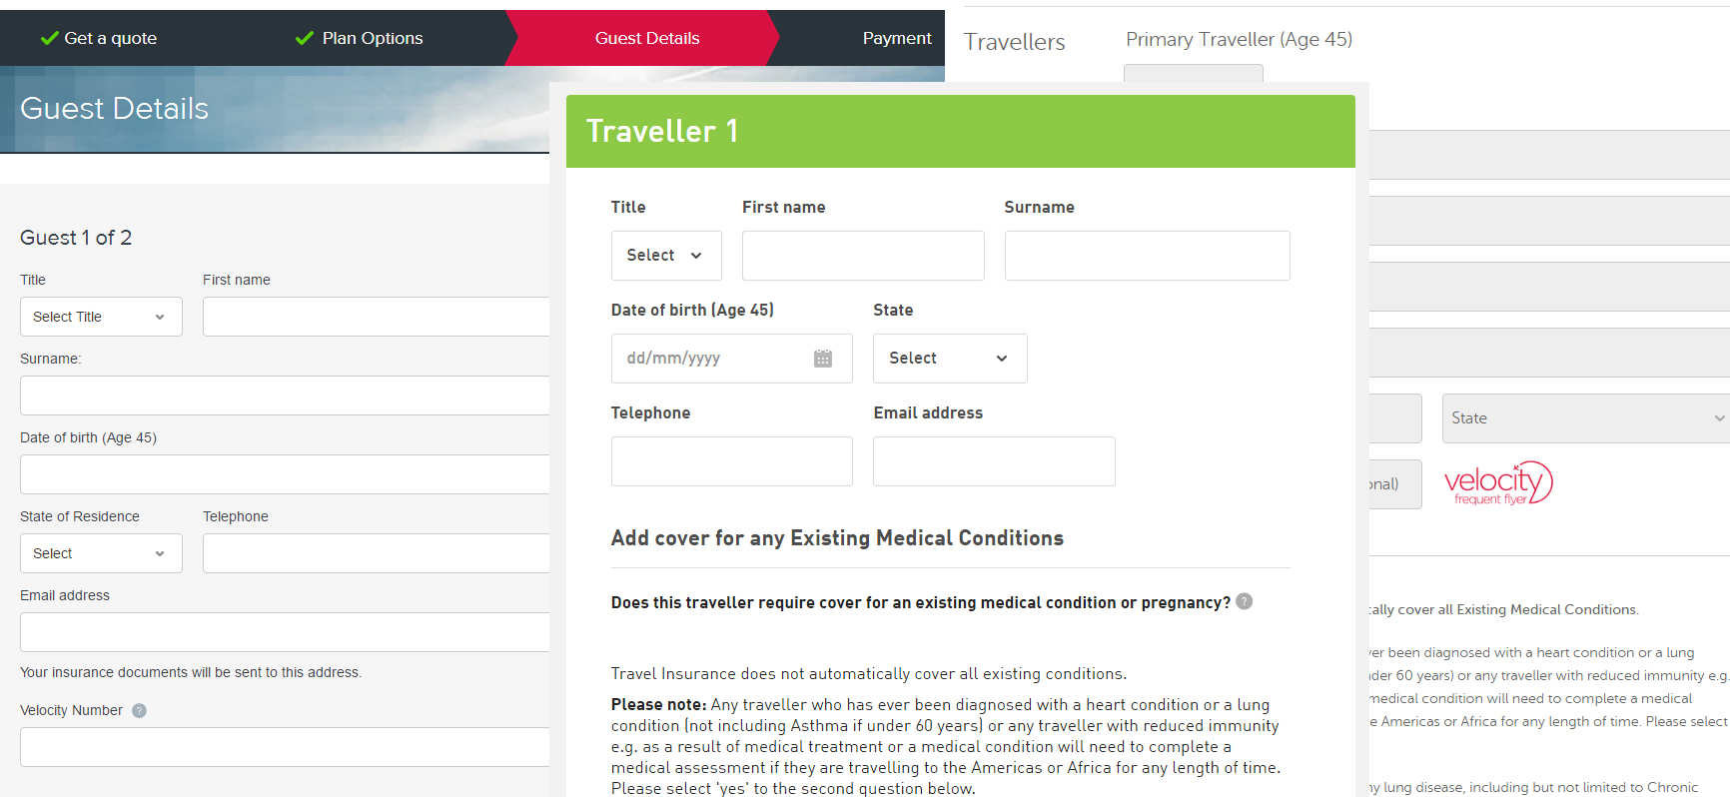
Notes:
12
12

Slide 13
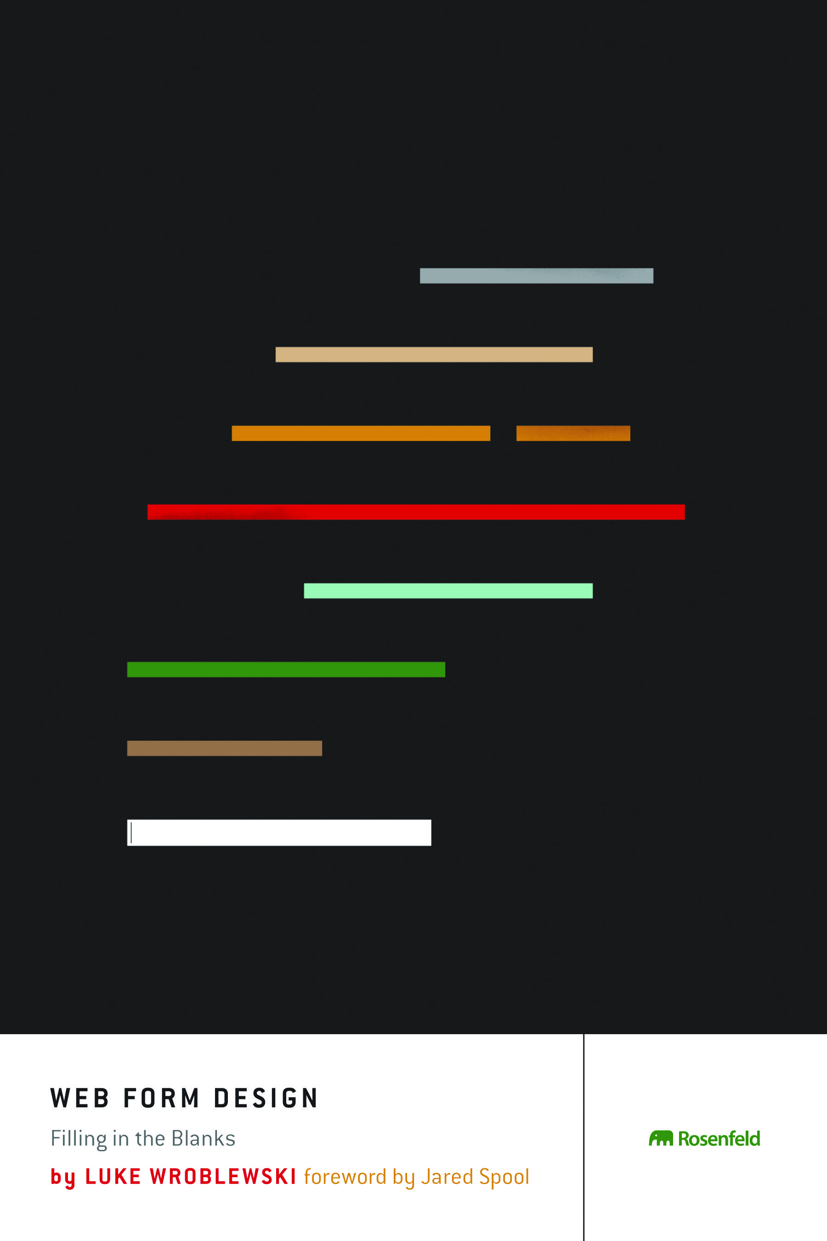
Notes:
13
13

Slide 14
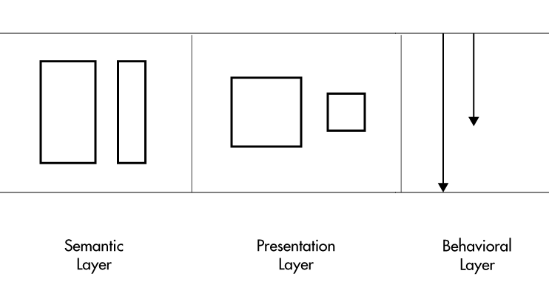
Notes:
14
14

Slide 15

Notes:
15
15

Slide 16
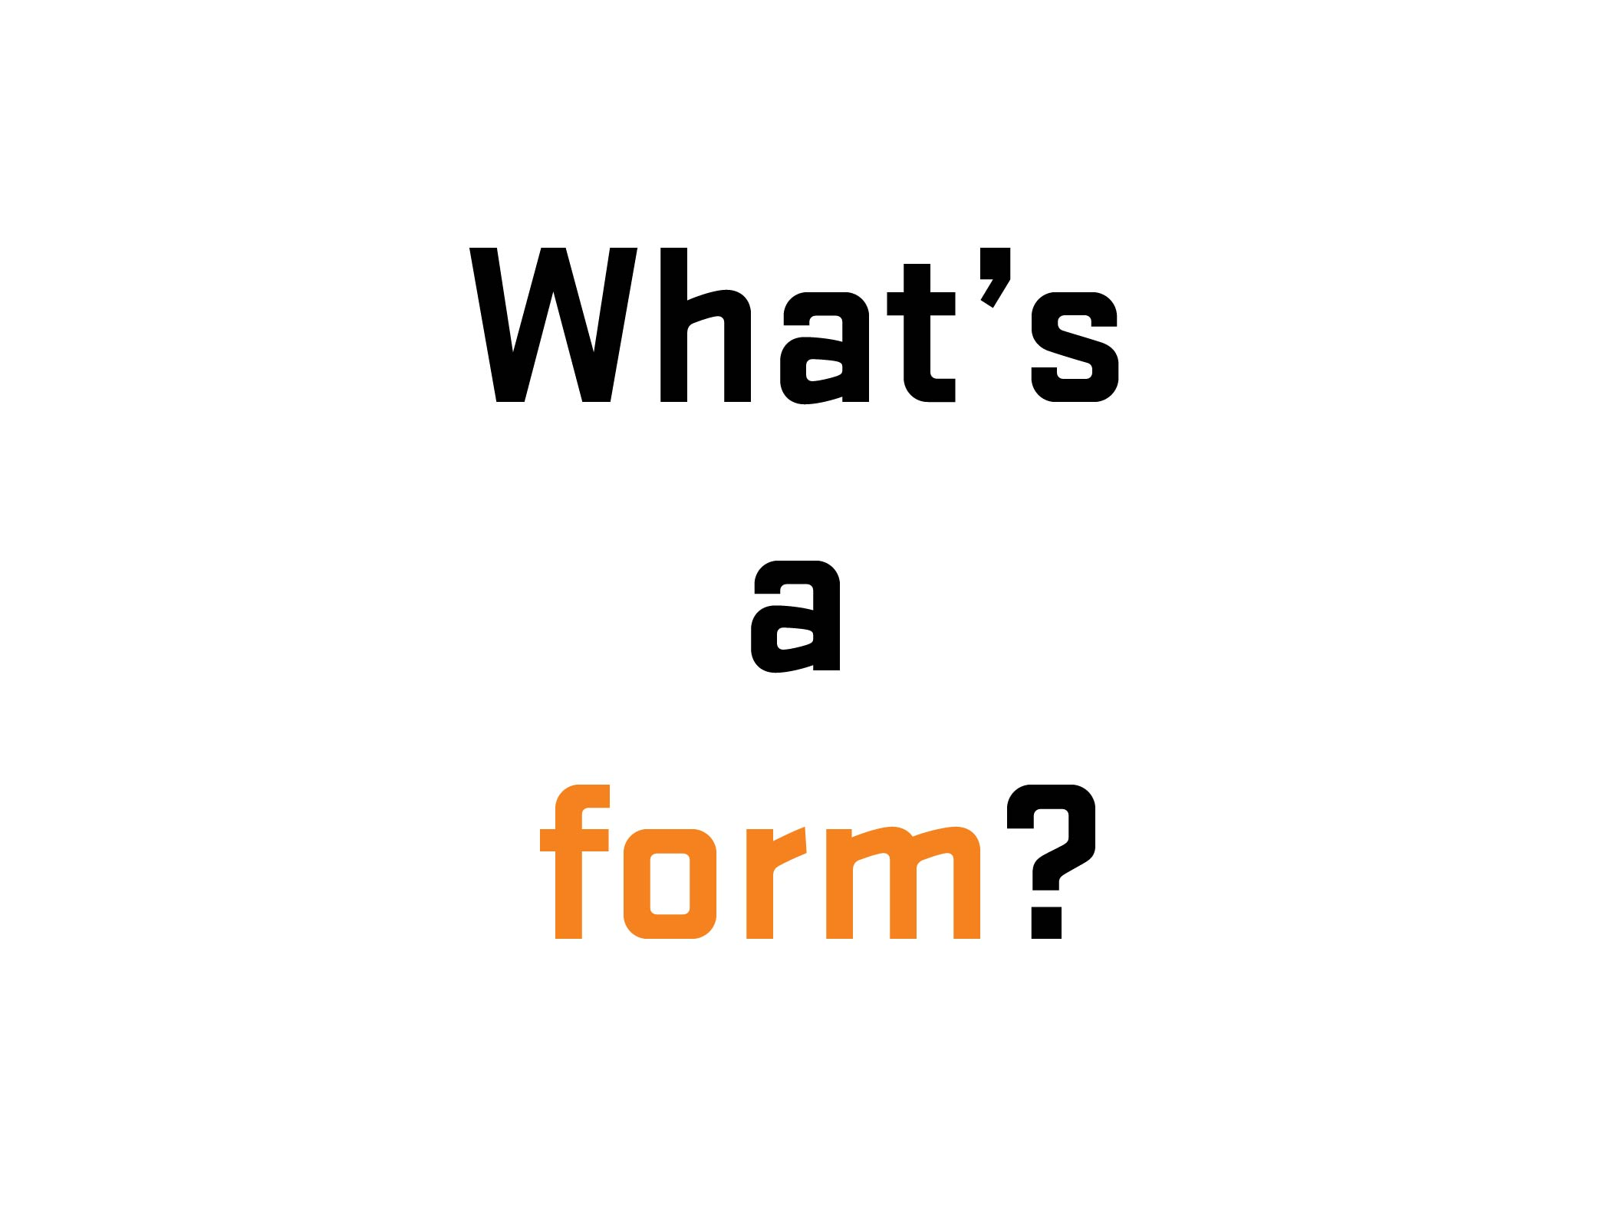
Notes:
16

Slide 17
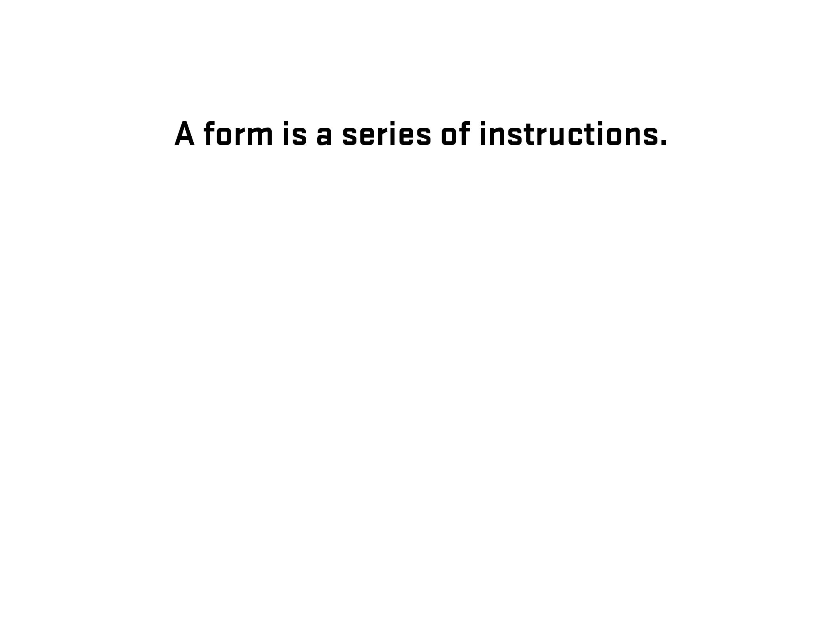
Notes:
17

Slide 18
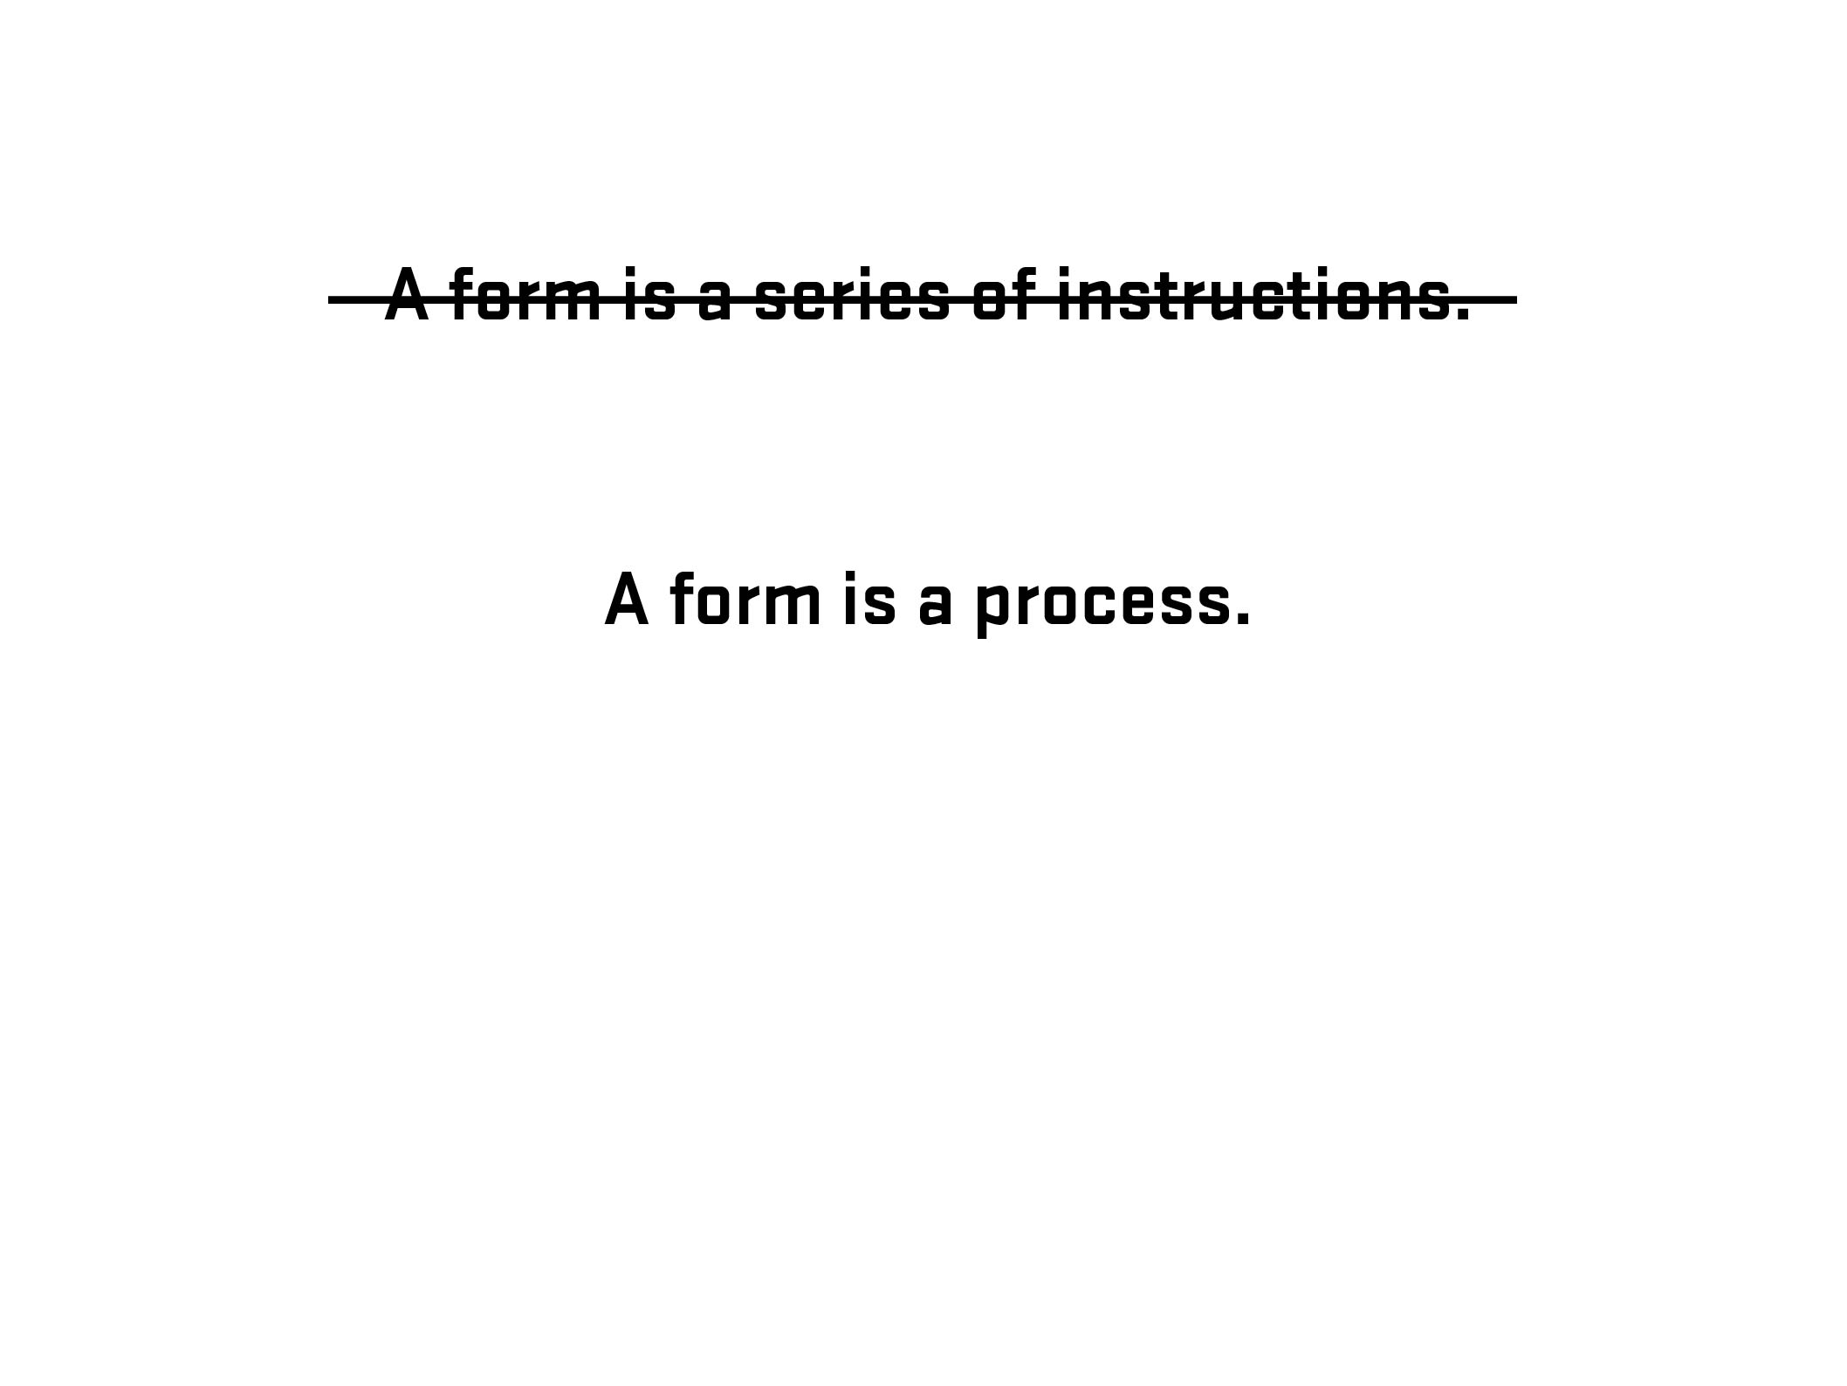
Notes:
18

Slide 19
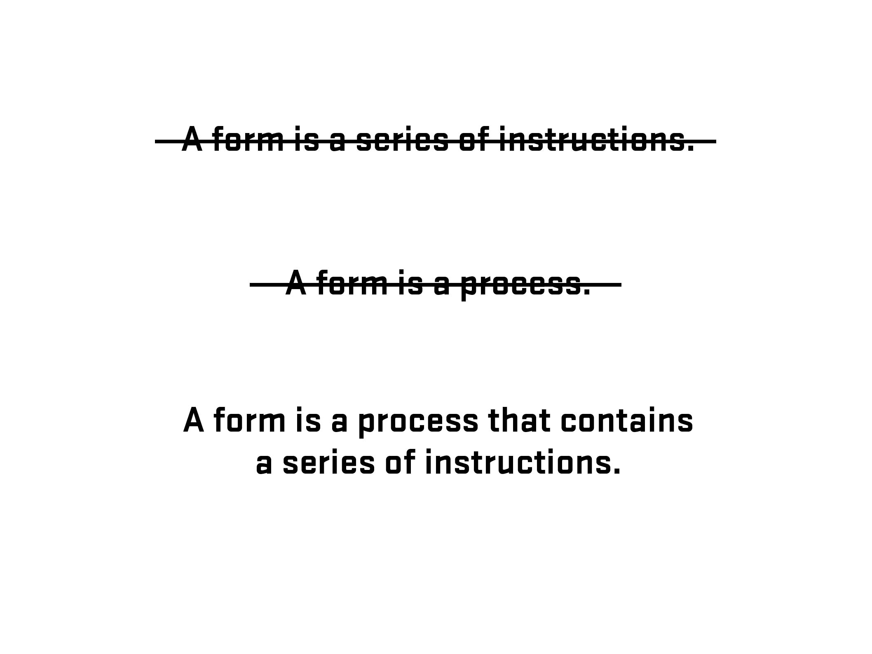
Notes:
19

Slide 20
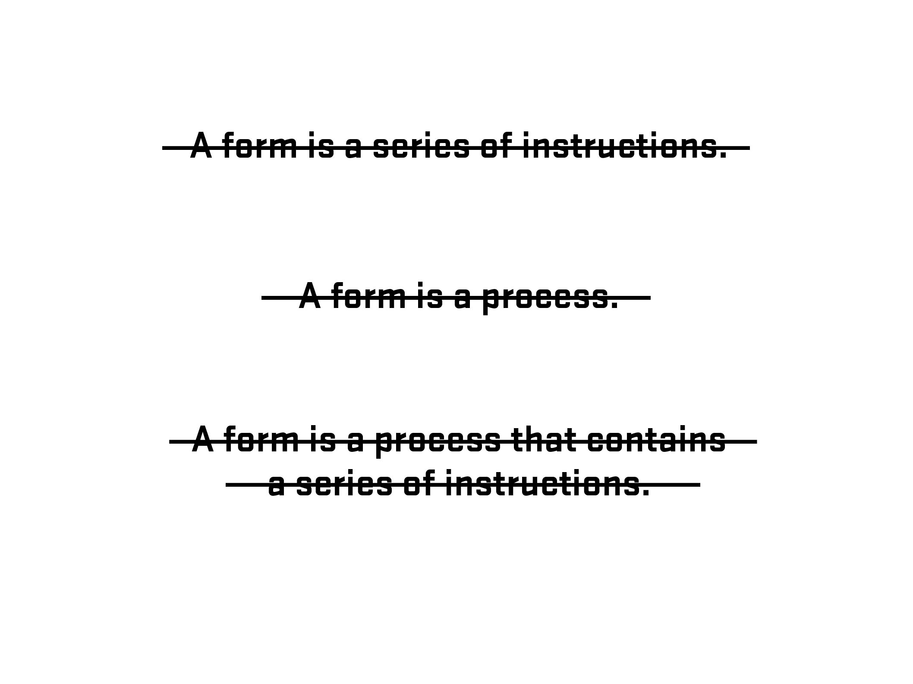
Notes:
20

Slide 21
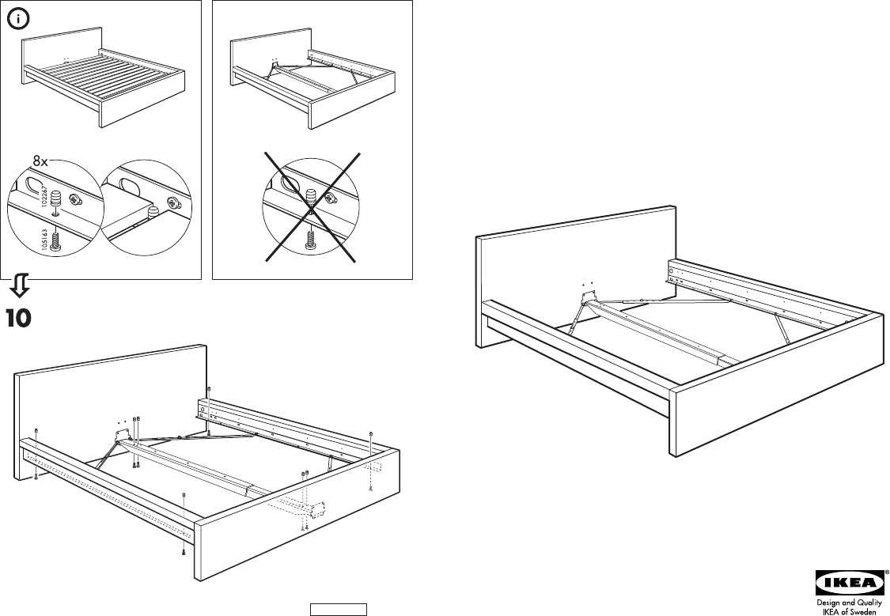
Notes:
21

Slide 22

Photo – Space Lab, Vancouver, Canada (Clint Moroz)
Notes:
22

Slide 23
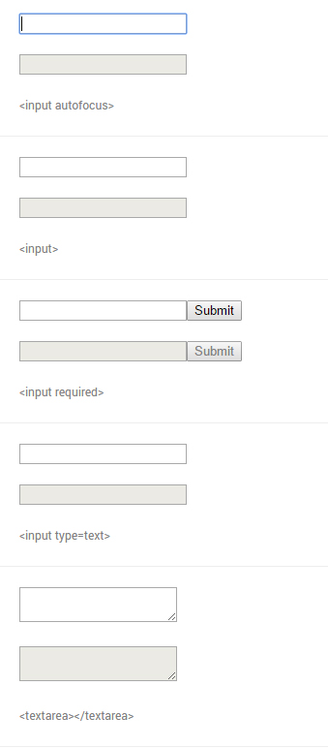
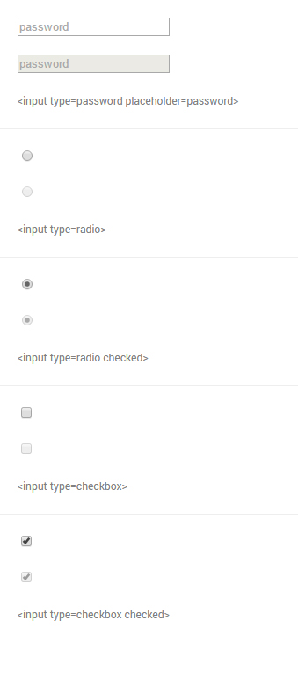
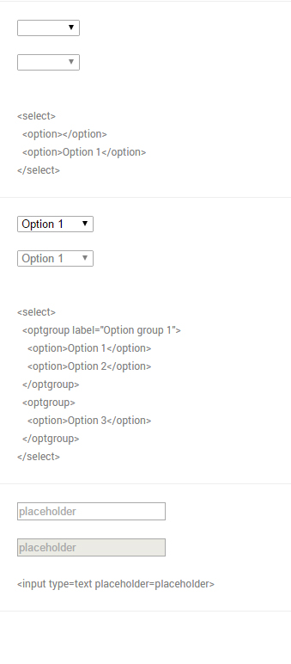
From Native form elements (http://nativeformelements.com/) - Joshua Jenkins
Notes:
23

Slide 24
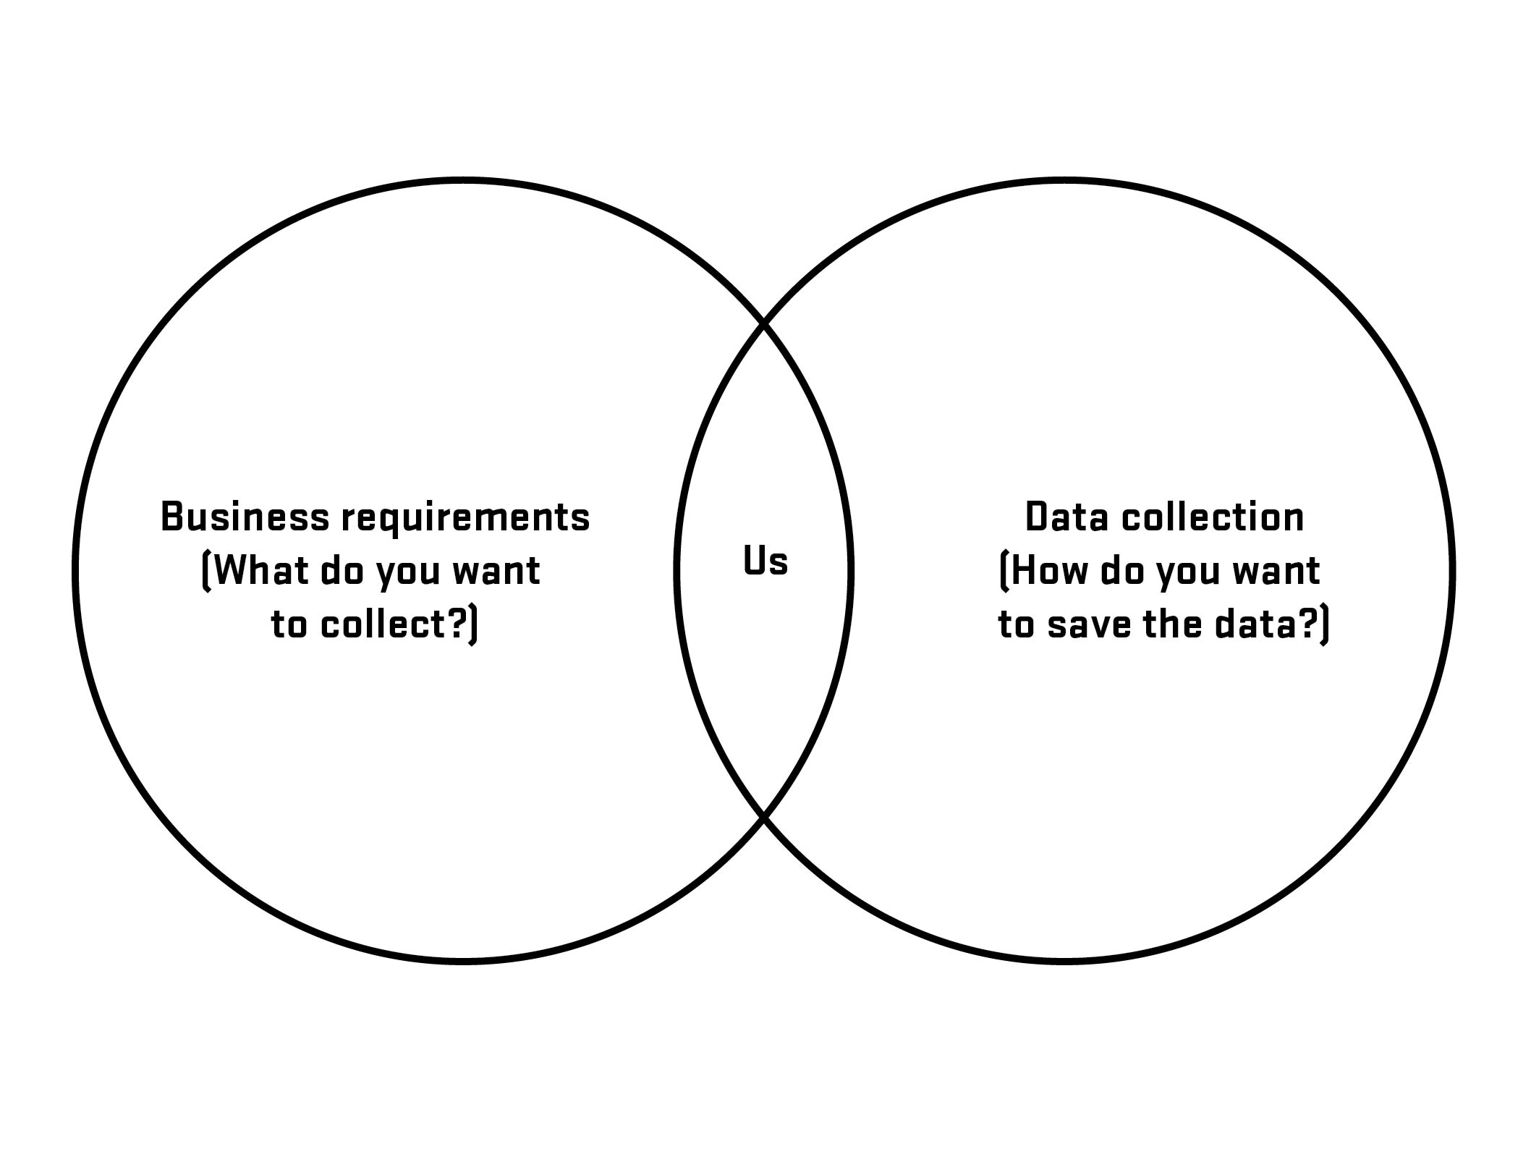

Slide 25
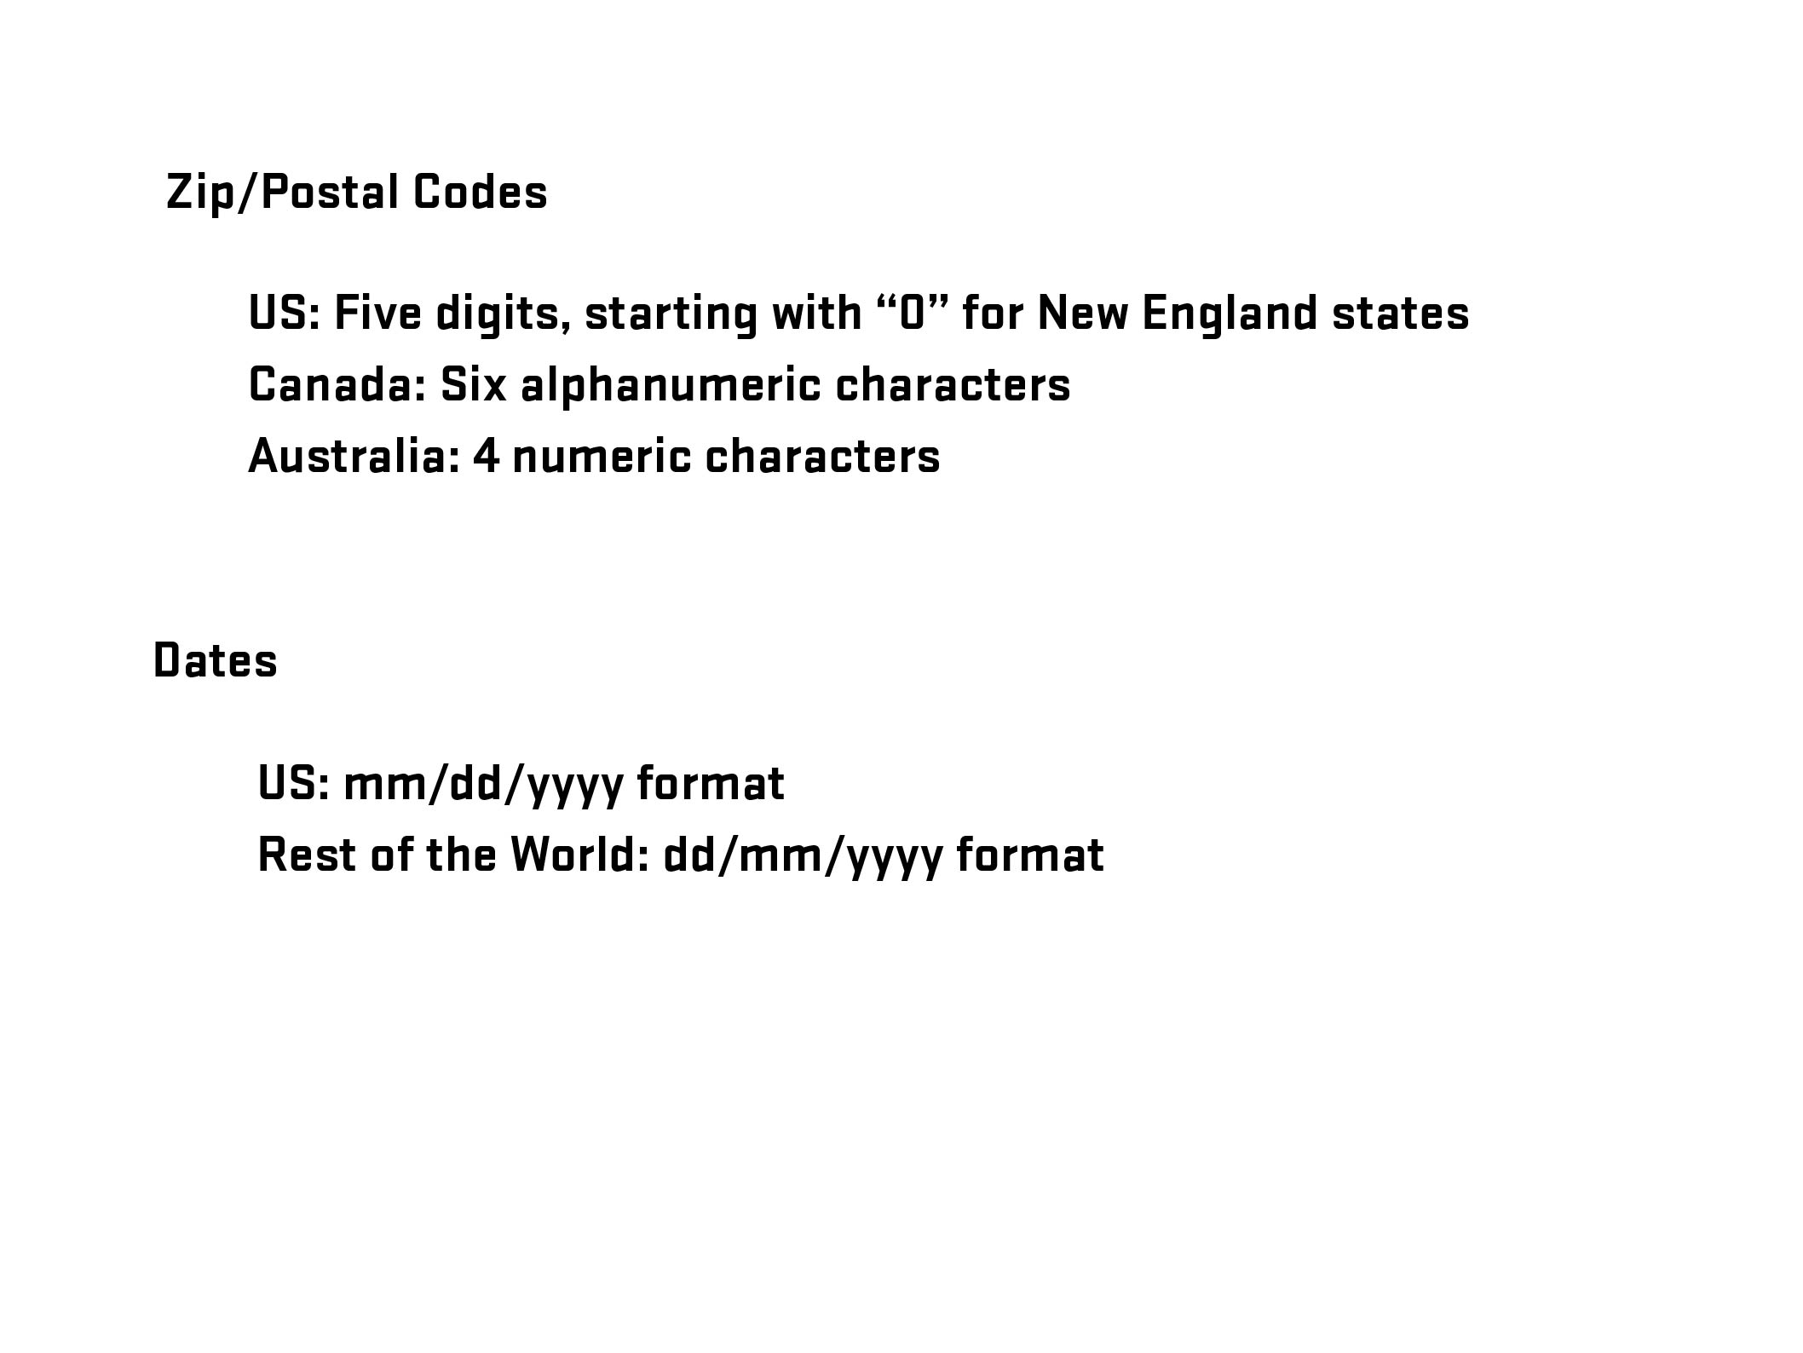

Slide 26
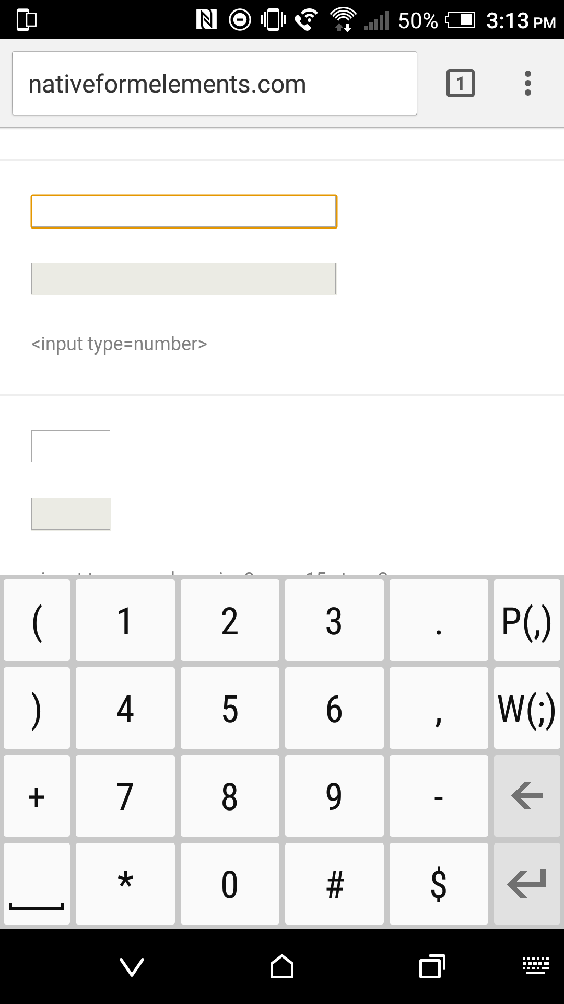

Notes:
26

Slide 27
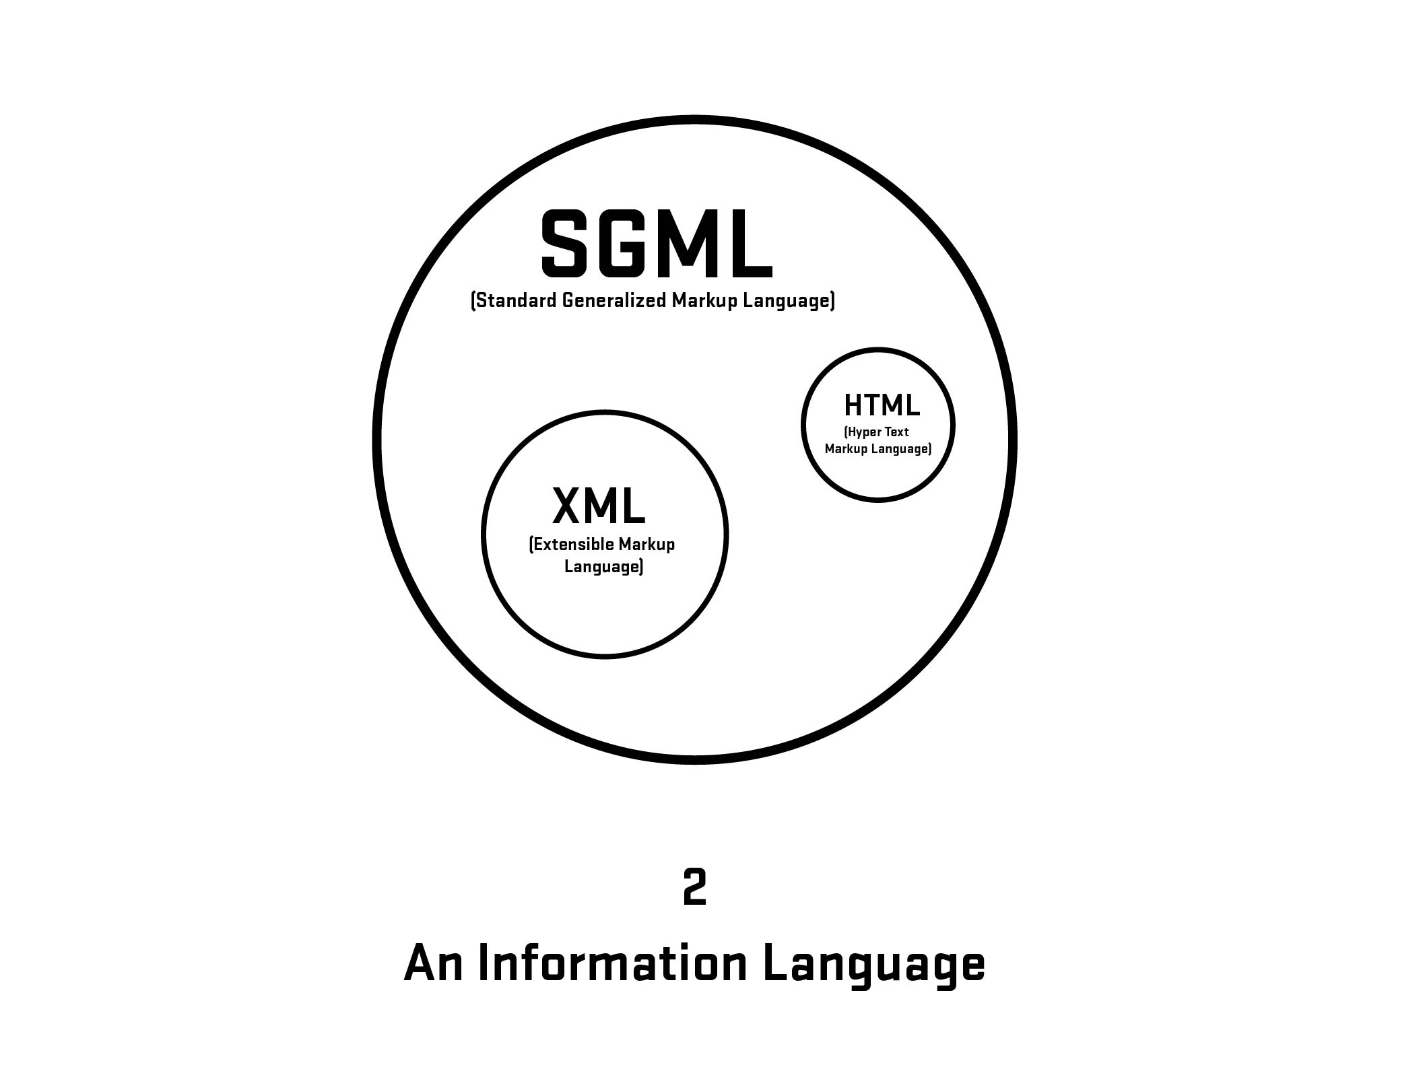
Notes:
27

Slide 28
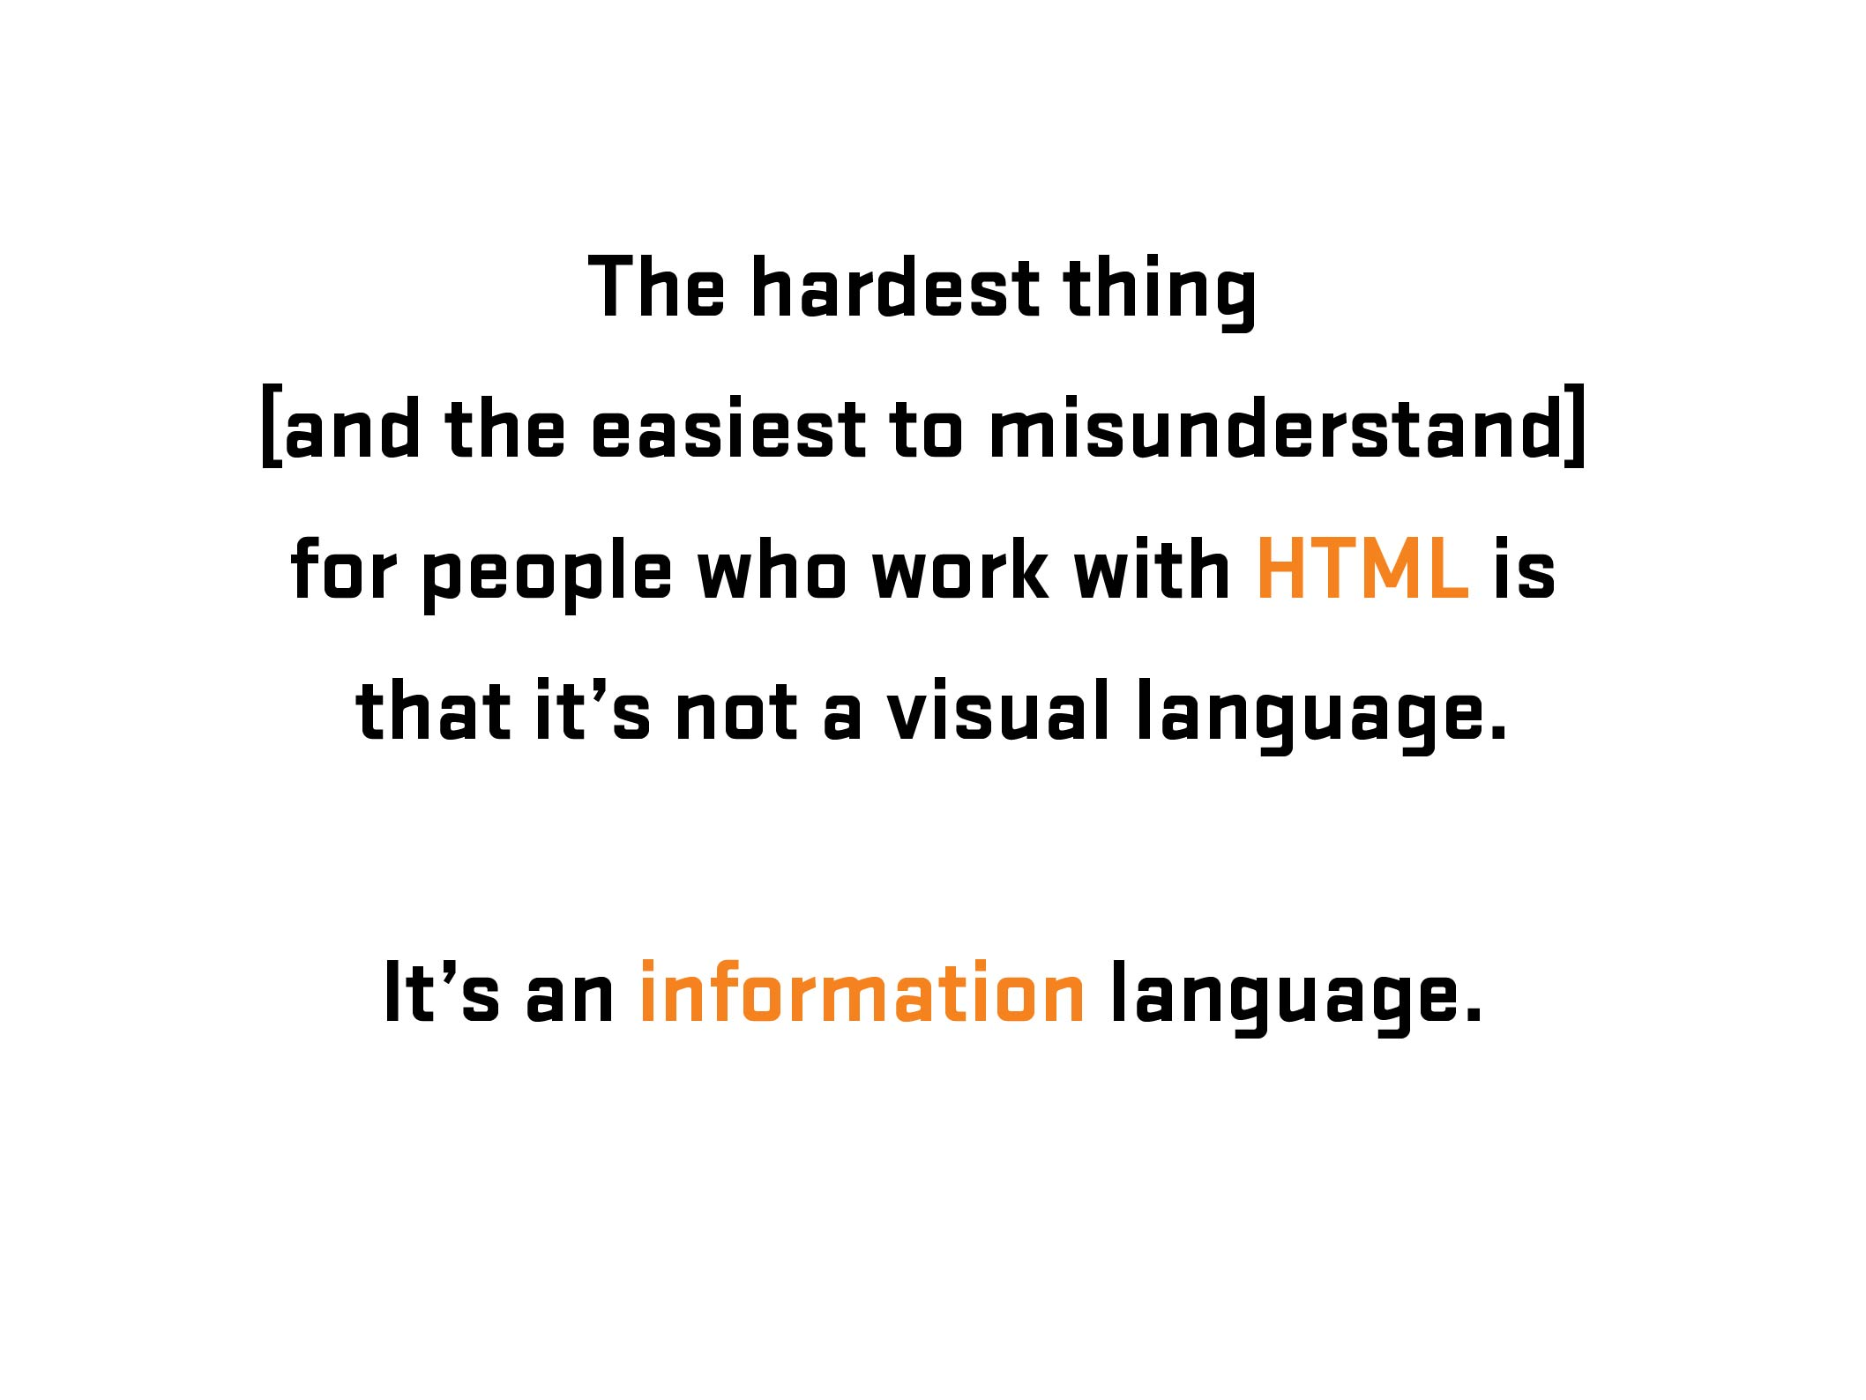
Notes:
28
28

Slide 29

More Information: https://en.wikipedia.org/wiki/Kaieteur_Falls
Notes:
29
Kaiteur Falls, Guyana
29

Slide 30

Notes:
30
Kaiteur Falls, Guyana
30

Slide 31
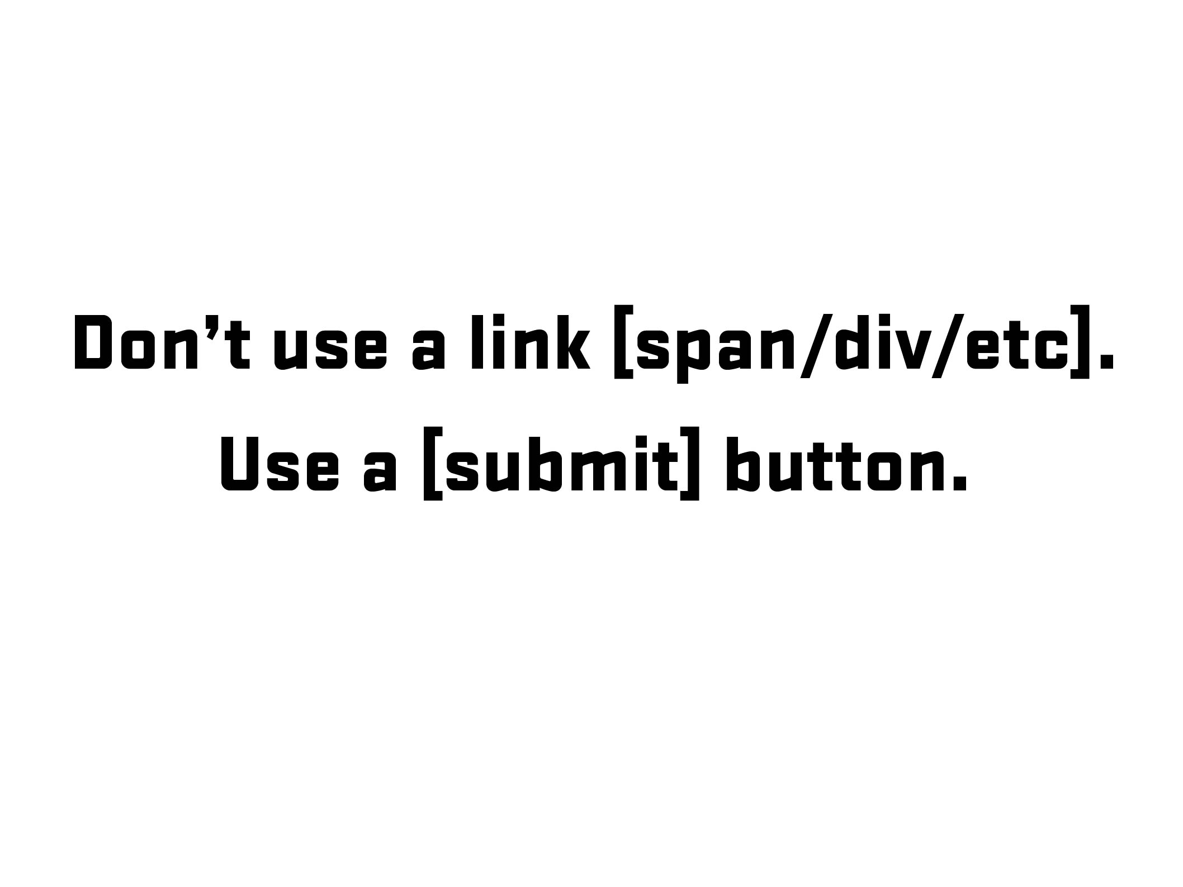

Slide 32
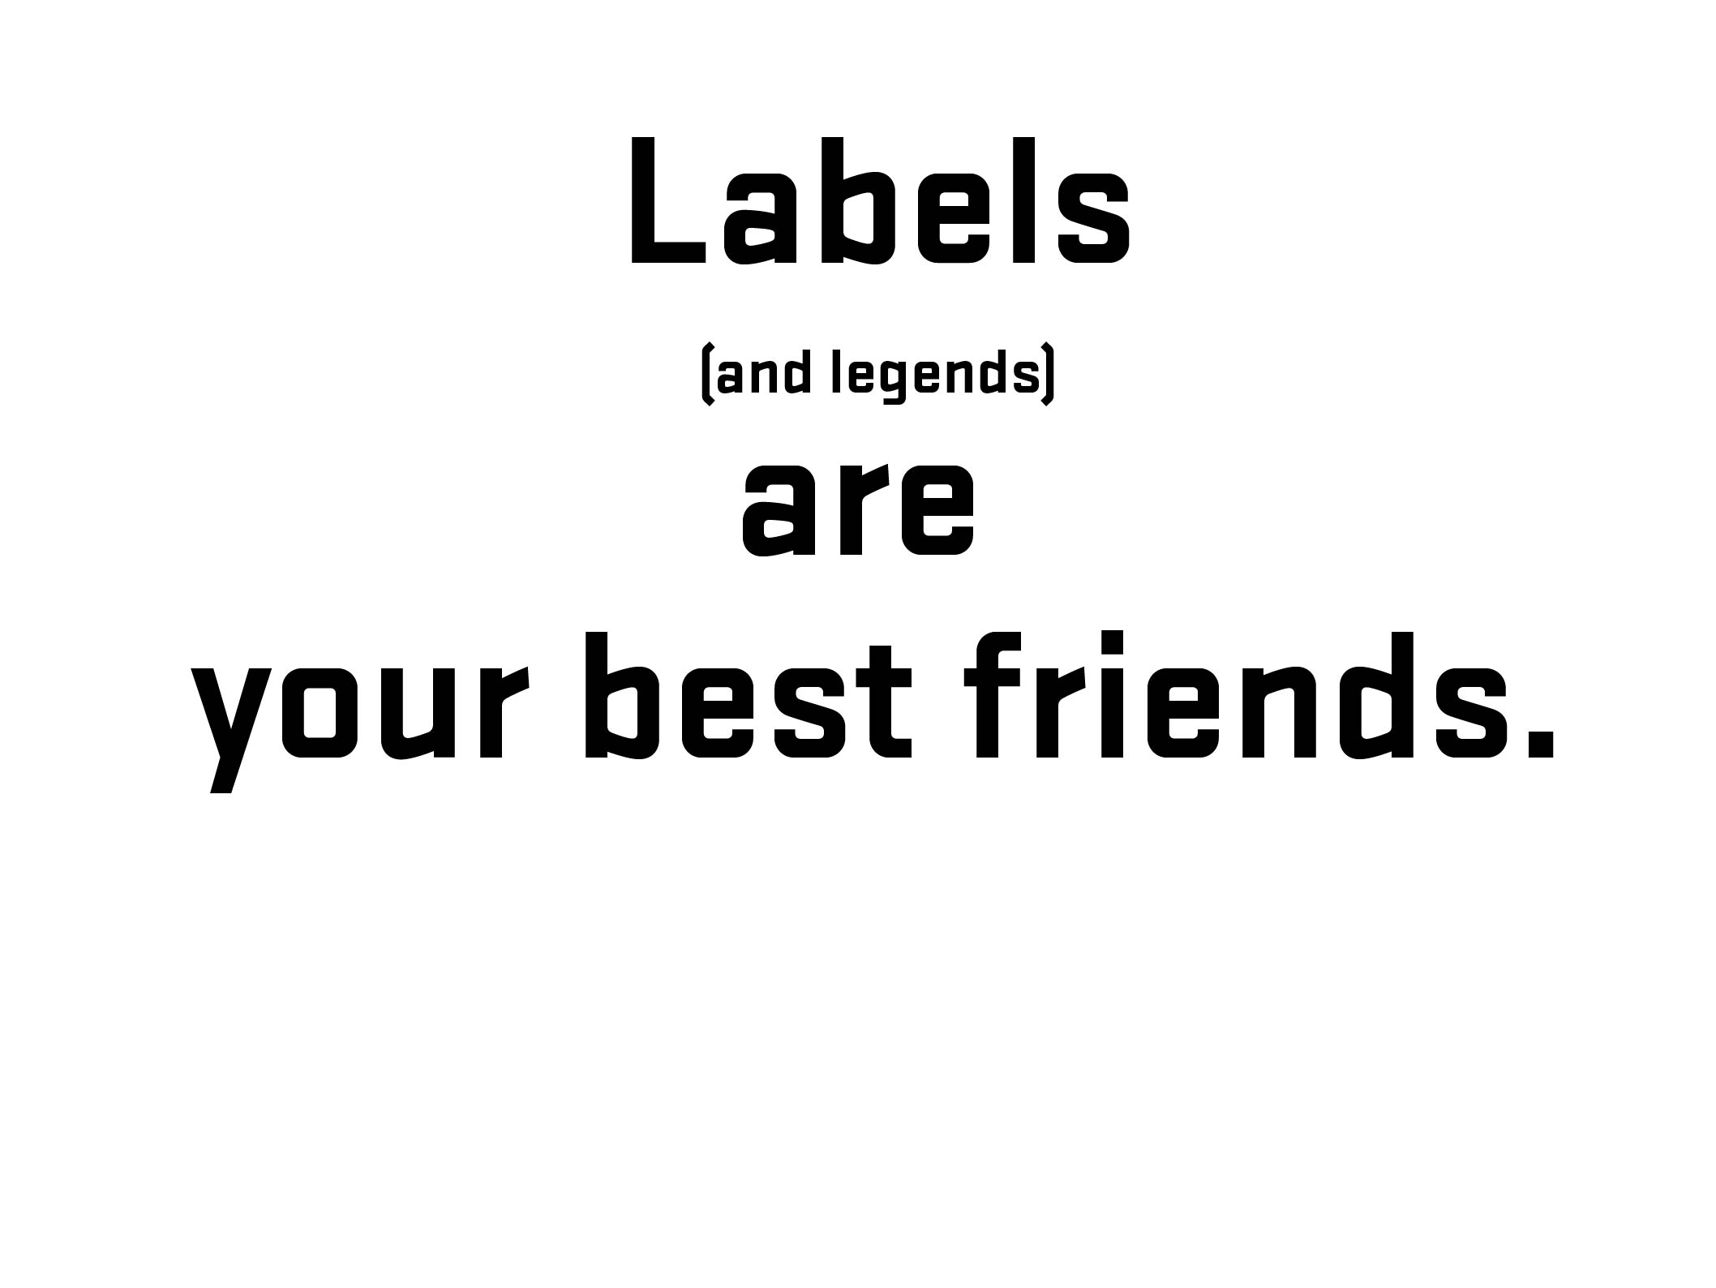

Notes:
32
Before going further – 1) explain what labels are and 2) what is that difference between placeholder and labels (and why that is important)
32

Slide 33
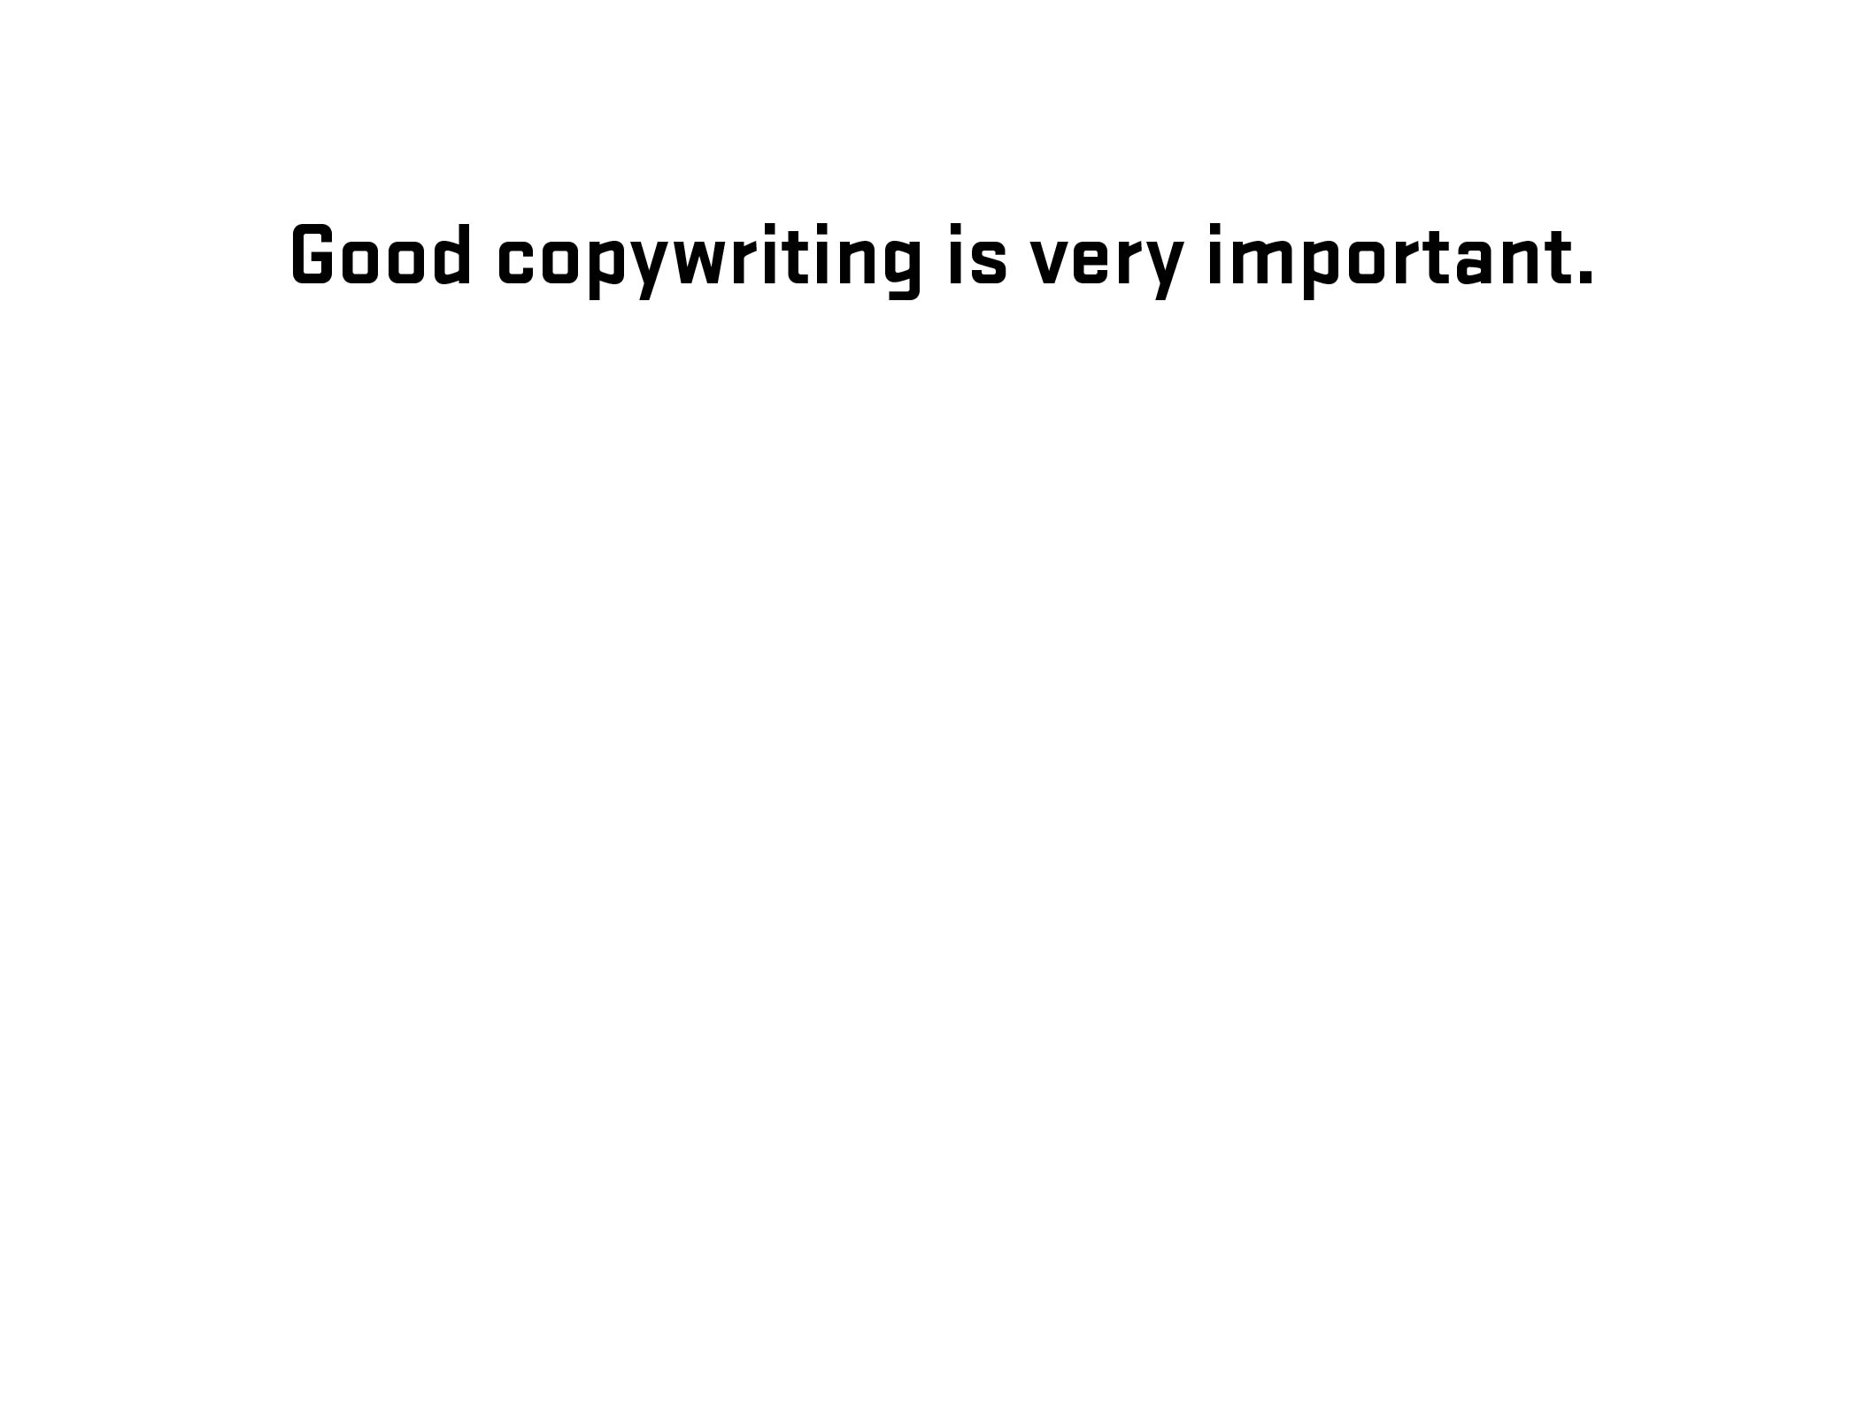
Notes:
33
Diversion – side note about good writing for labels (copywriting)
33

Slide 34
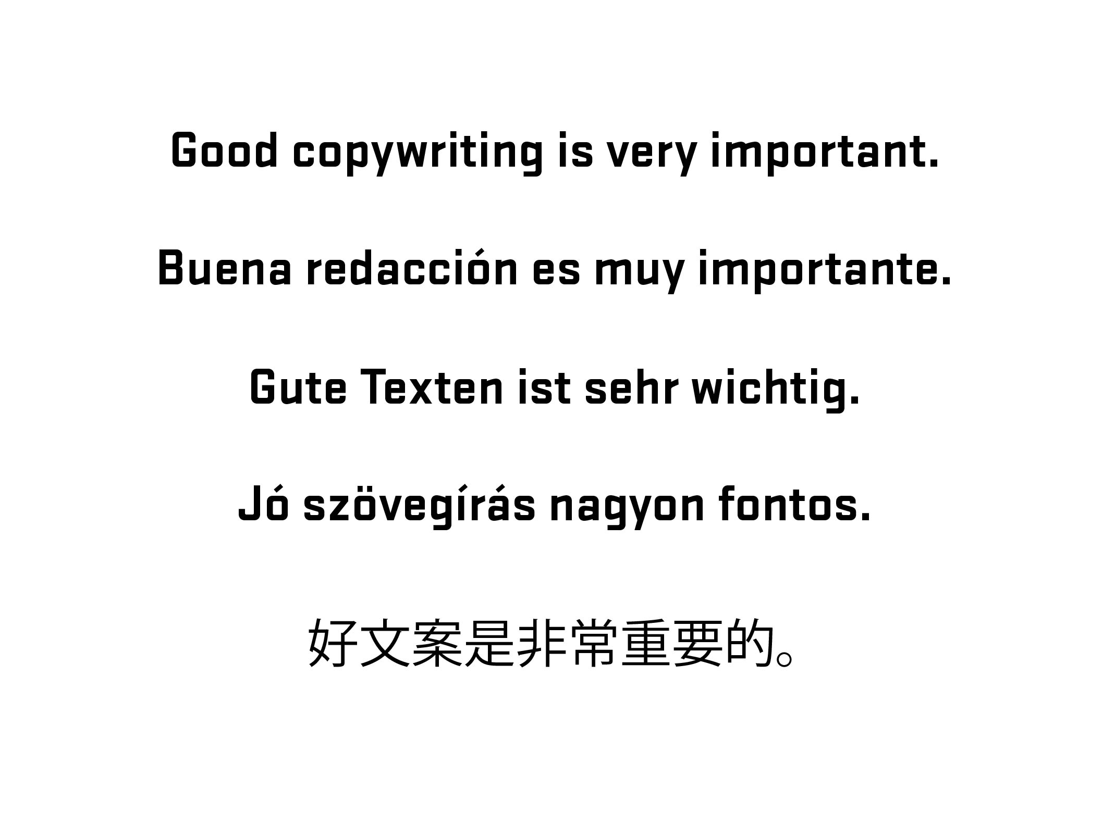
Notes:
34
Diversion – side note about good writing for labels (copywriting)
34

Slide 35
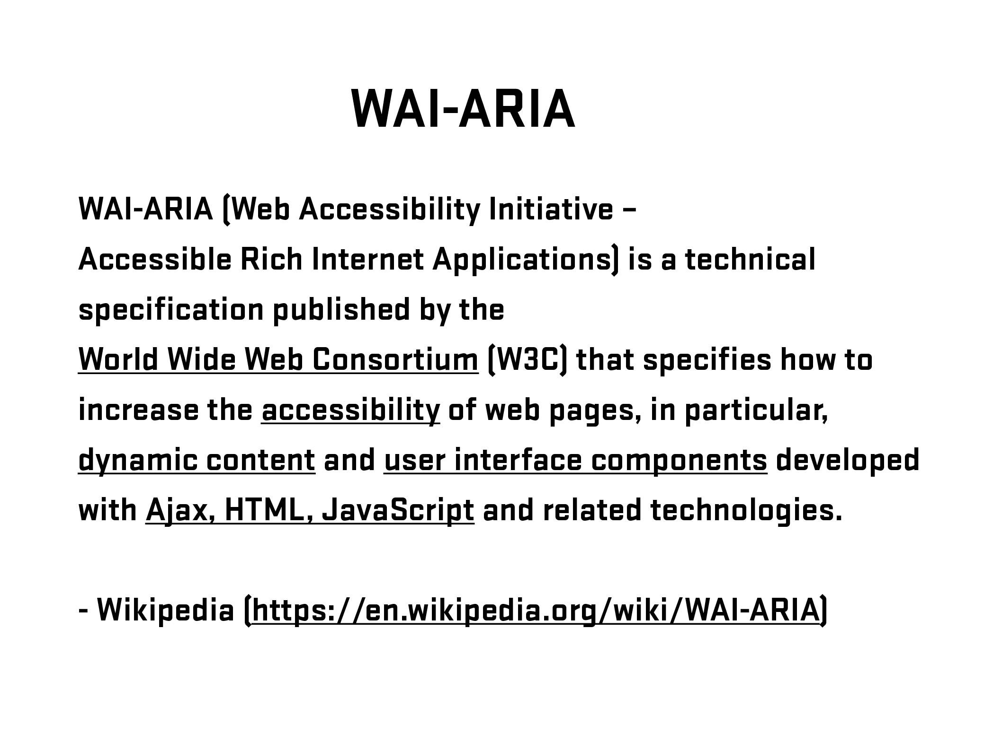
Notes:
35
Brief overview of history/explanation. Go further if needed – refer to W3C.
Need list of resources for audience
35

Slide 36
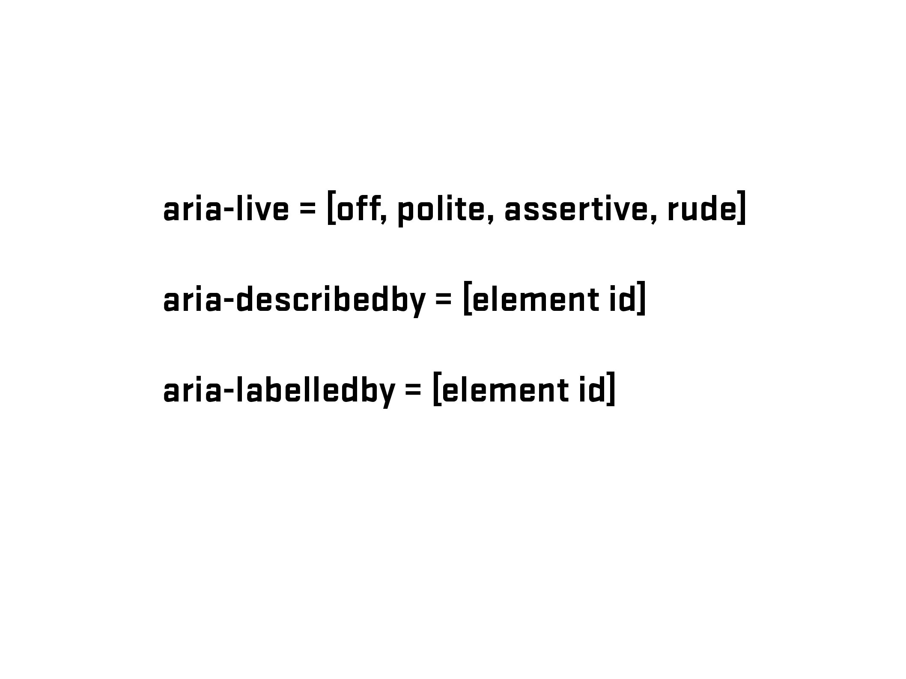
Notes:
36

Slide 37
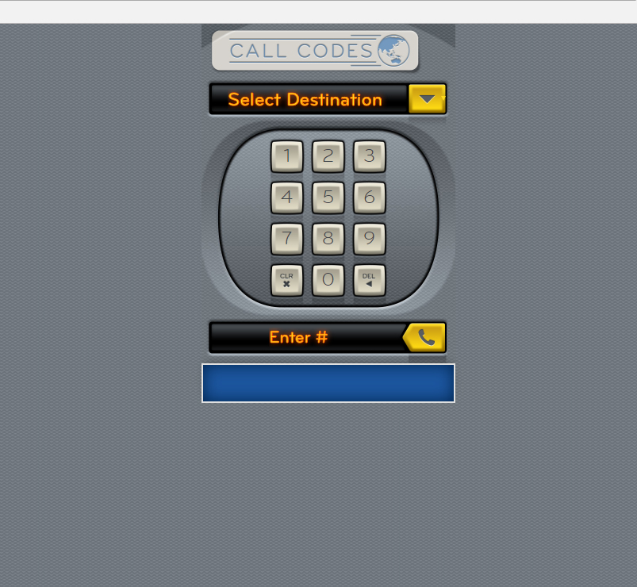

Slide 38
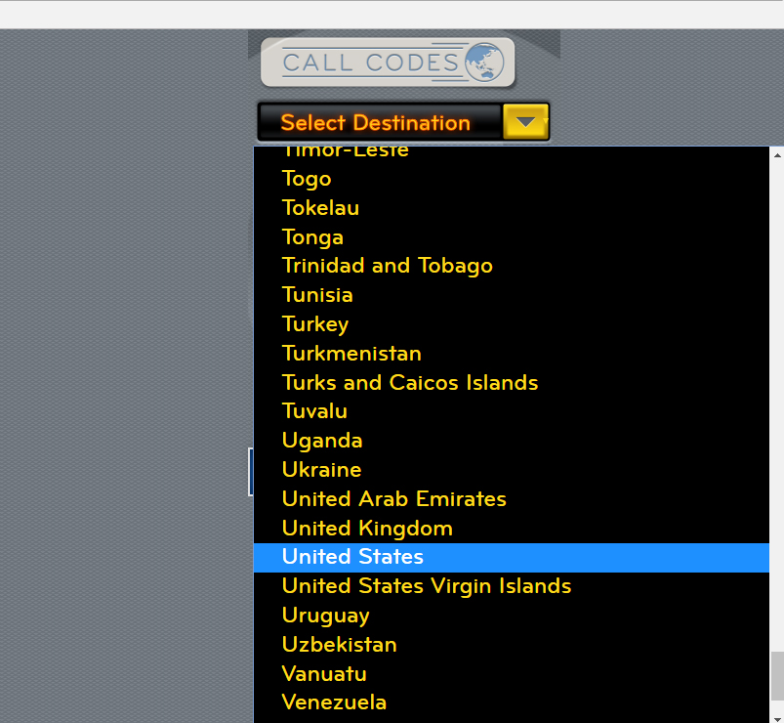

Slide 39
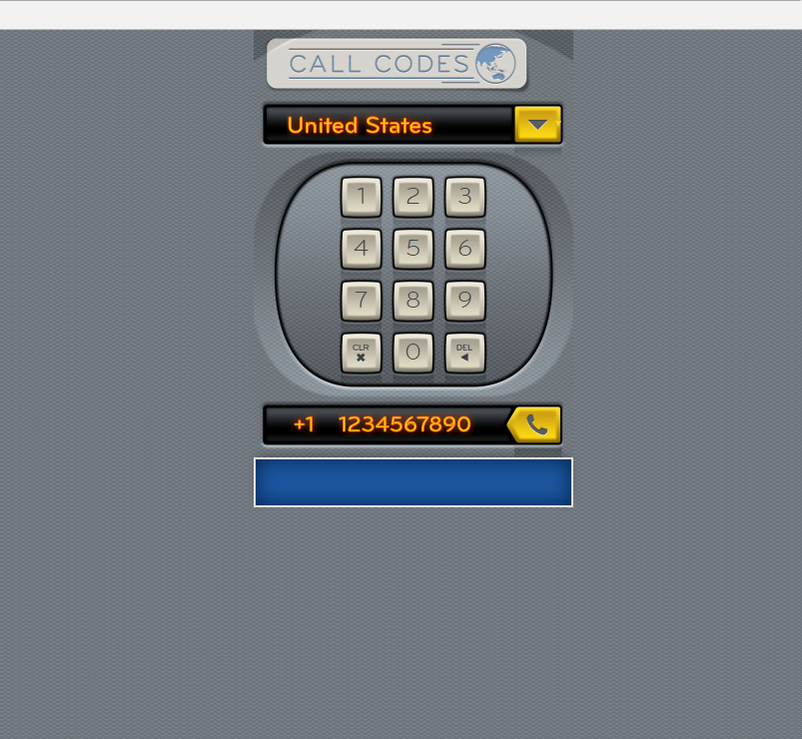

Slide 40
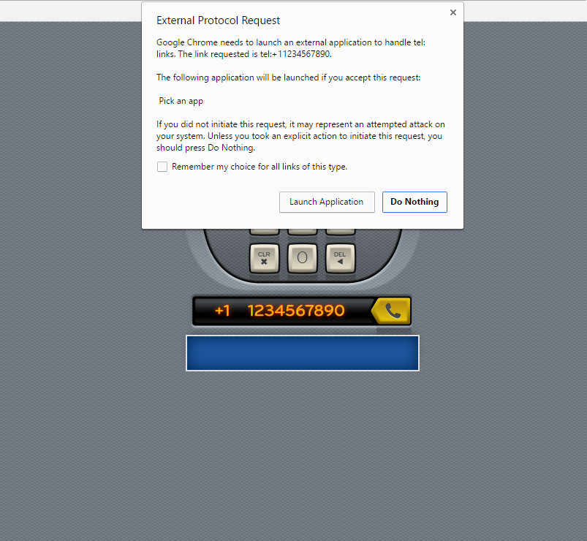

Slide 41
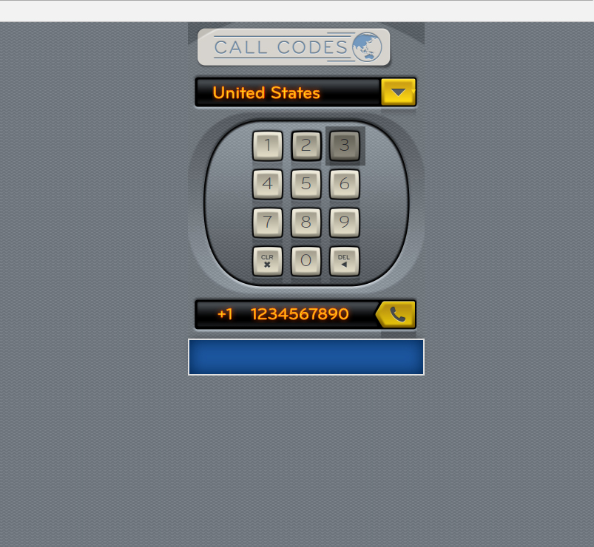
<span>3</span>

Slide 42
<button type="button">3</button>

Slide 43
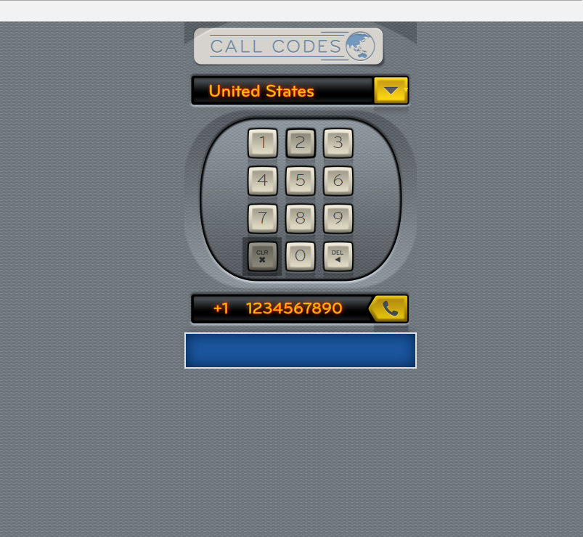
<span class="clearButton"><img src="files/images/icons/icon-clear-key-touch.png" width="17" height="18" alt="Clear"></span>

Slide 44
<input type="reset" class="clearButton" value="Clear Number">

Slide 45
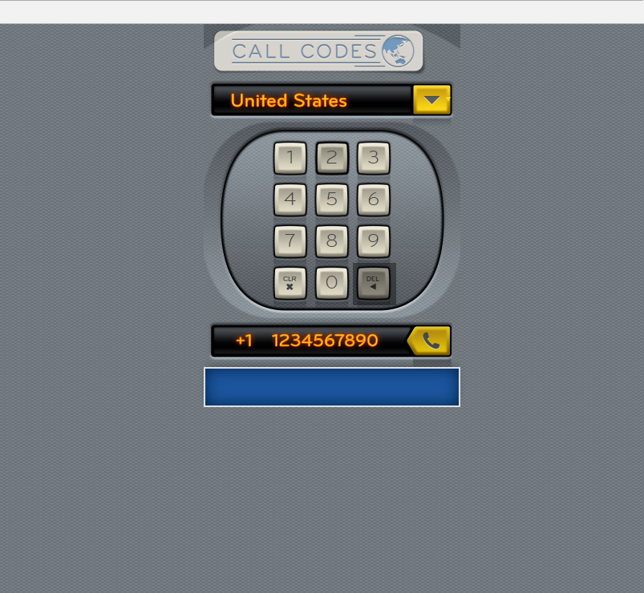
<span class="deleteNumber"><img src="files/images/icons/icon-del-key-touch.png" width="17" height="18" alt="<"></span>

Slide 46
<button type="button" class="deleteNumber">Delete Numbers</button>

Slide 47
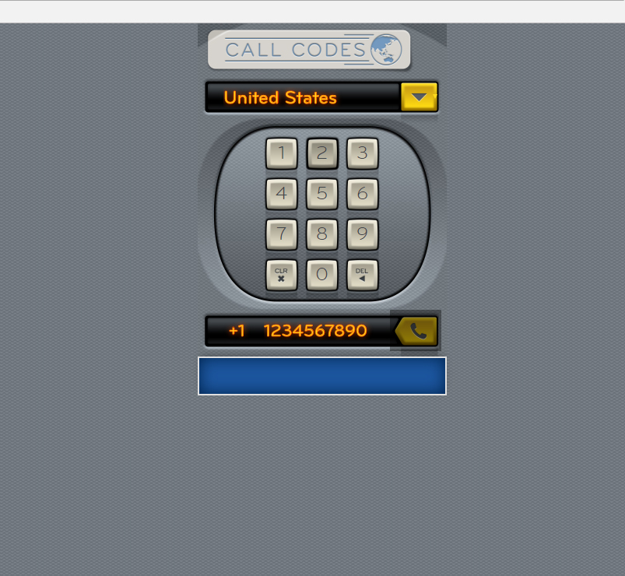
<a href="#" class="callButton ui-link"></a>

Slide 48
<input type="submit" name="call" value="Call Number" class="callButton">

Slide 49
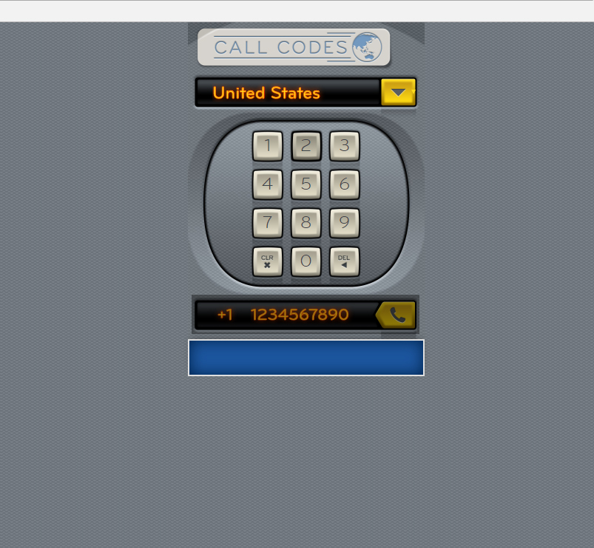
JS - Add aria-live=“polite” when the full number (10 characters) has been reached – indicating number is ready to be called

Slide 50
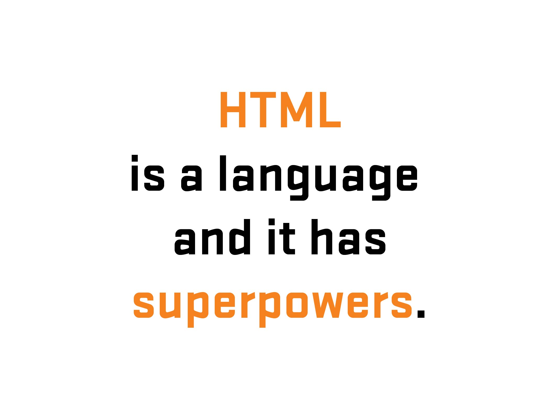

Slide 51
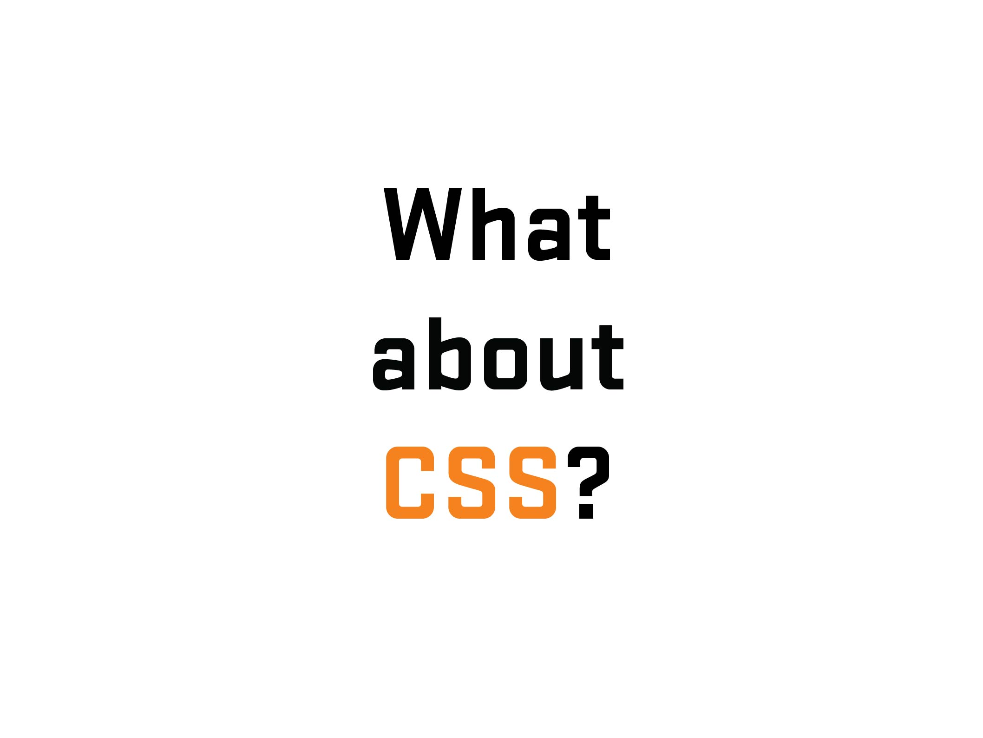
Notes:
51

Slide 52

Notes:
52

Slide 53
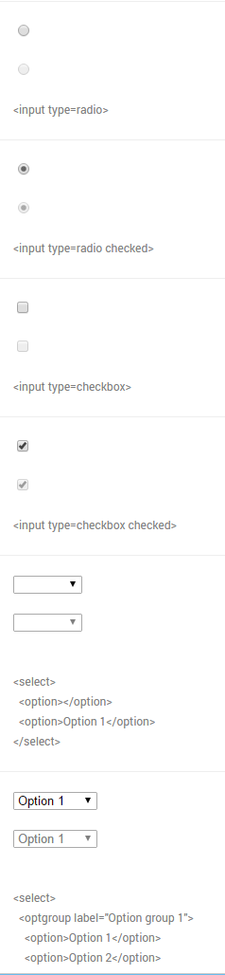
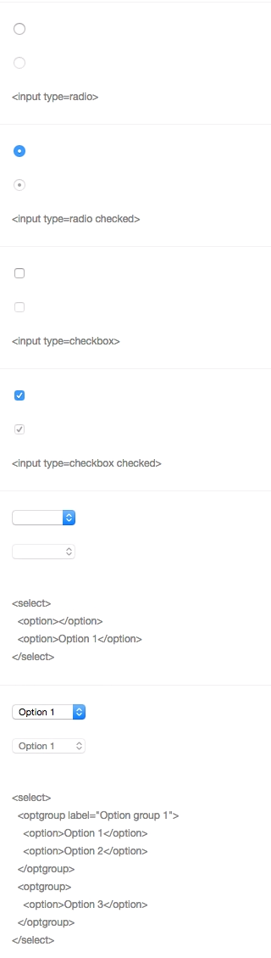
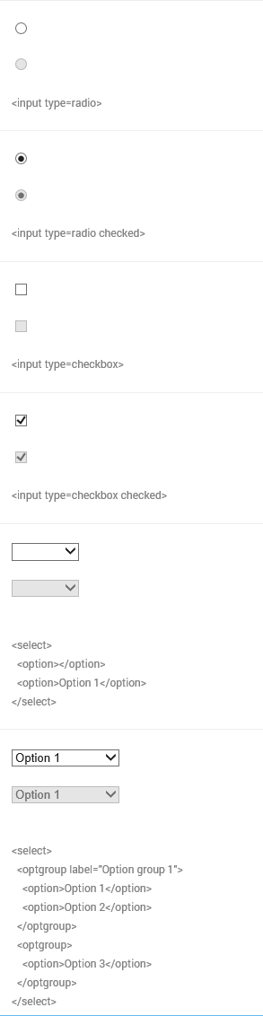

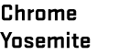

Notes:
53
Differences of form UI’s among browsers/platforms
53

Slide 54
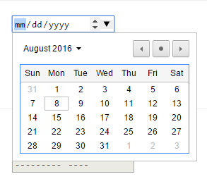
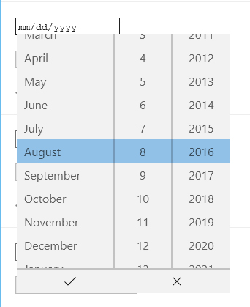


Notes:
54
Another example – Date input (different look/functionality/UI) – Desktop
Go to nativeformelements.com for brief demo
54

Slide 55
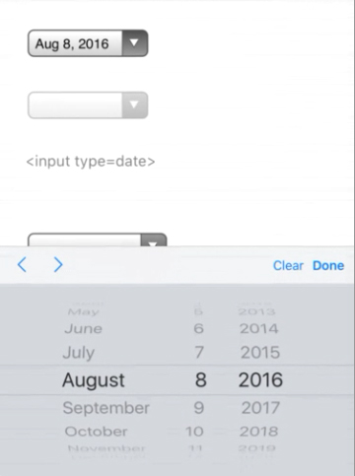



Notes:
55
Another example – Date input (different look/functionality/UI) - Mobile
55

Slide 56


Slide 57


Slide 58

Notes:
58
Before going further – 1) explain what labels are and 2) what is that difference between placeholder and labels (and why that is important)
58

Slide 59



Slide 60


Slide 61


Slide 62


Slide 63

Notes:
63
youGo – travel insurance for under 30 crowd/Cover-More
63

Slide 64
Notes:
64
64
youGo/unlucky explanation – Visual (Choice #1)
Form with four set of radio buttons – no submit
(demo form)
Go to youGo site for demo - http://yougotravelinsurance.com.au/

Slide 65

Notes:
65
65
youGo/unlucky explanation – Visual/Code (Choice #1)

Slide 66

Notes:
66
66
youGo/unlucky explanation – Visual/Code (Choice #1)

Slide 67

Notes:
67
67
youGo/unlucky explanation – Visual/Code (Choice #1)

Slide 68

Notes:
68
68
youGo/unlucky explanation – Visual/Code (Choice #1)

Slide 69


Notes:
69
69
youGo/unlucky explanation – Visual/Code (Choice #1)

Slide 70


Slide 71


Slide 72


Slide 73


Slide 74


Slide 75


Slide 76


Slide 77


Slide 78


Slide 79


Slide 80



Slide 81

Notes:
81
Solved problem with two prong/server page approach – one desktop/one mobile. Which is an viable option (see McGrane/adaptive solutions). But at the time, it had hiccups (serving wrong page, etc.). Not a mess but not an ideal (responsive) solution.
81

Slide 82

Notes:
82
If I had a chance, what would I do…
So I wrote some notes…
82

Slide 83


Notes:
83
First thing, change the codebase (responsive/reduced JS/a11y?)
Allowed for direct data input (no JS)
Single code base (responsive)
A11y???
83

Slide 84

Notes:
84
Going back to the base – information language
84

Slide 85

Notes:
85

Slide 86

Notes:
86

Slide 87

Notes:
87

Slide 88

Notes:
88
88

Slide 89

Notes:
89

Slide 90

Notes:
90
No JS in data entry – used for display/toggle
90

Slide 91
.ui-countryselector input[type="radio"]
+ label ~ div.columns {
overflow: hidden;
float: none;
position: absolute;
clip: rect(0,0,0,0);
width: 100%;
height: 0;
margin: 0;
padding: 0;
}
Notes:
91
91

Slide 92
If a region is not selected,
hide related countries
Notes:
92
92

Slide 93
If a region is selected,
show related countries
Notes:
93
93

Slide 94
.ui-countryselector input[type="radio"]:checked
+ label ~ div.columns {
position: static;
height: auto;
}
Notes:
94
94

Slide 95
.ui-countryselector input[type="radio"] + label ~ div.columns { overflow: auto; }
Notes:
95
95

Slide 96

.ui-countryselector input[type="radio"]:checked + label ~ div.columns { float: left; height: 384px; }
Notes:
96
Note – hard to do due to bugs. Adjacent bug in both iOS (“+” didn’t work) and Android (needed fix). Thankfully, fixed in more recent versions.
96

Slide 97

Notes:
97
I found out during QA testing and was able to remove or work around some of the barriers.
97

Slide 98

Notes:
98
No excuse for not testing – getting problems out of the way. For the initial work, even had to test for Android 2.3…But the way, a moment of silence….
98

Slide 99


Slide 100


Slide 101

Notes:
101
101

